Slide 1
Making the Switch
The Plan for Upgrading Orange County to the Next Generation ePCR
February 4th, 2015

Slide 2
Objectives
Provide a “snapshot” of the OC-MEDS ePCR system as it exists today.
Discuss reasons for transition to NEMSIS 3.
Discuss the steps needed for the whole county to operationally transition to a NEMSIS 3 compliant system.
Discuss the plan for the future…HIE.

Slide 3
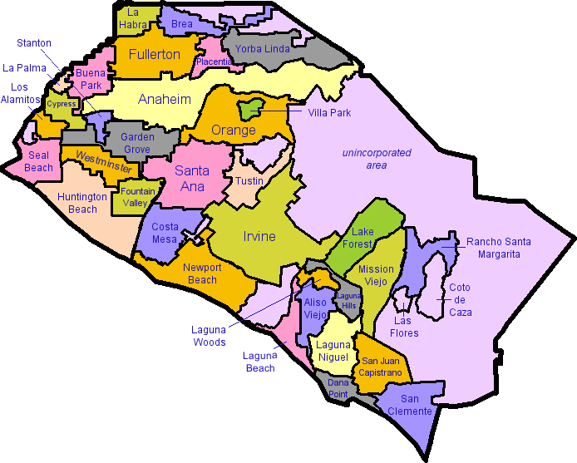
About Orange County
Population: 3,010,232
  2010 Census
  3rd most populous county in CA
  6th most populous county in the US
  More populous than 19 states
Area: 947 Square Miles
  34 Incorporated Cities
  2nd most densely populated county in CA

Slide 4

Orange County EMS System
170,000+ 9-1-1 EMS Responses Annually
12 Fire Departments
25+ Ambulance Companies
  350+ Licensed Ambulances
25 Emergency Departments
  6 Base Hospitals
  3 Trauma Centers
  14 STEMI Centers
  9 Stroke Centers

Slide 5


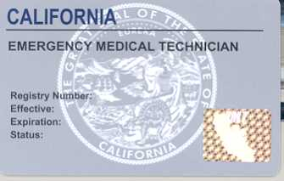
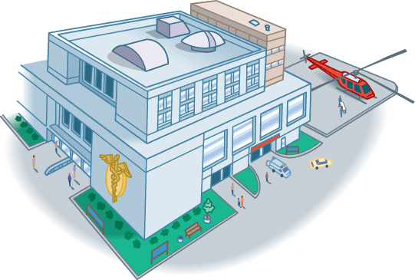


Current System “Snapshot”
License / Cert.
Patient Registry
Trauma
STEMI
Stroke
EMS / Base Hospital
ePCR / eBHR

Slide 6
Just the facts…
Based on NEMSIS 2.2.1
6,000+ users
ePCR Participating Agencies
  11 Fire Departments (98% - Since Dec.2013 )
  8 Ambulance Companies (20%)
eBHR Participating Base Hospitals
  6 Base Hospitals
Hospital Dashboard Participants
  25 Emergency Departments (100%)

Slide 7
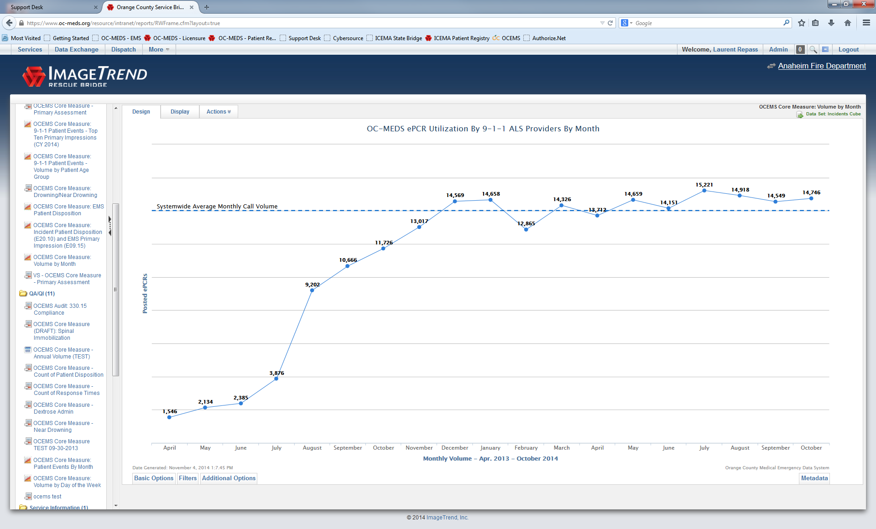

Slide 8
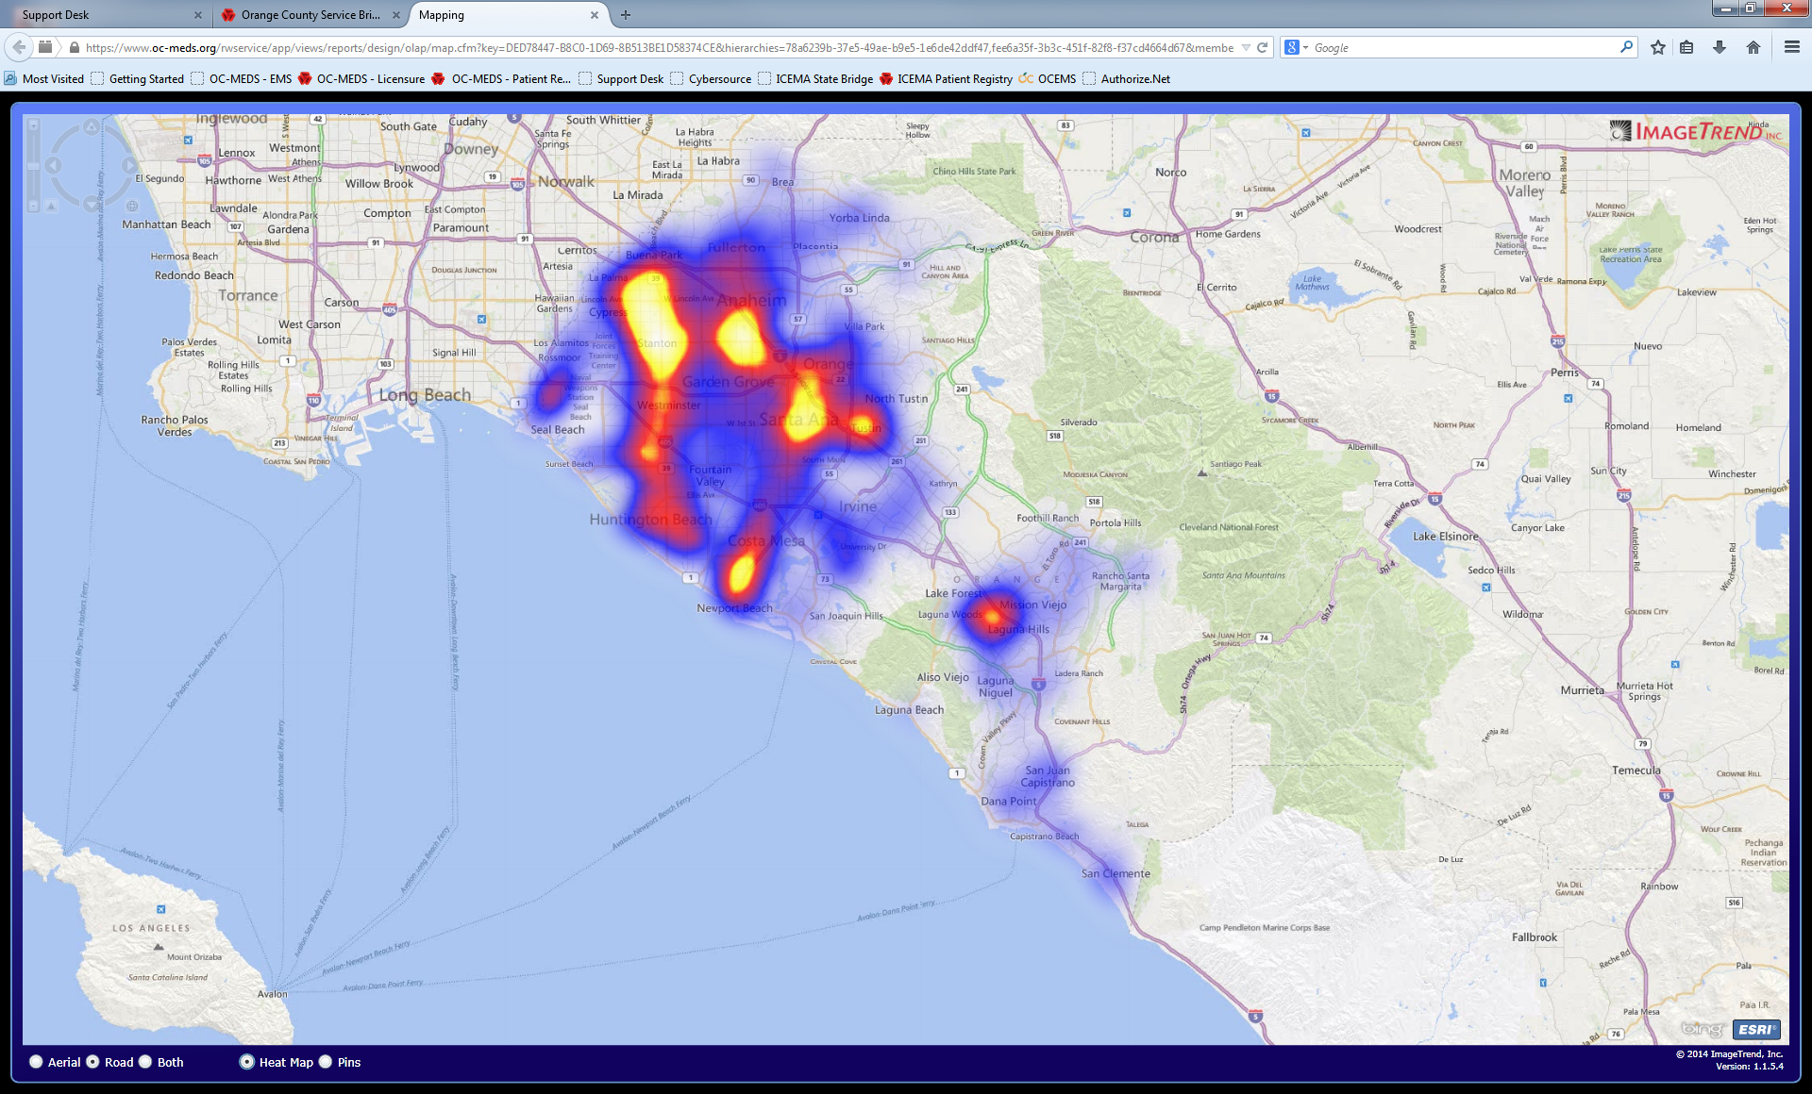
ePCR Usage (Heat Map) Oct. 2014

Slide 9
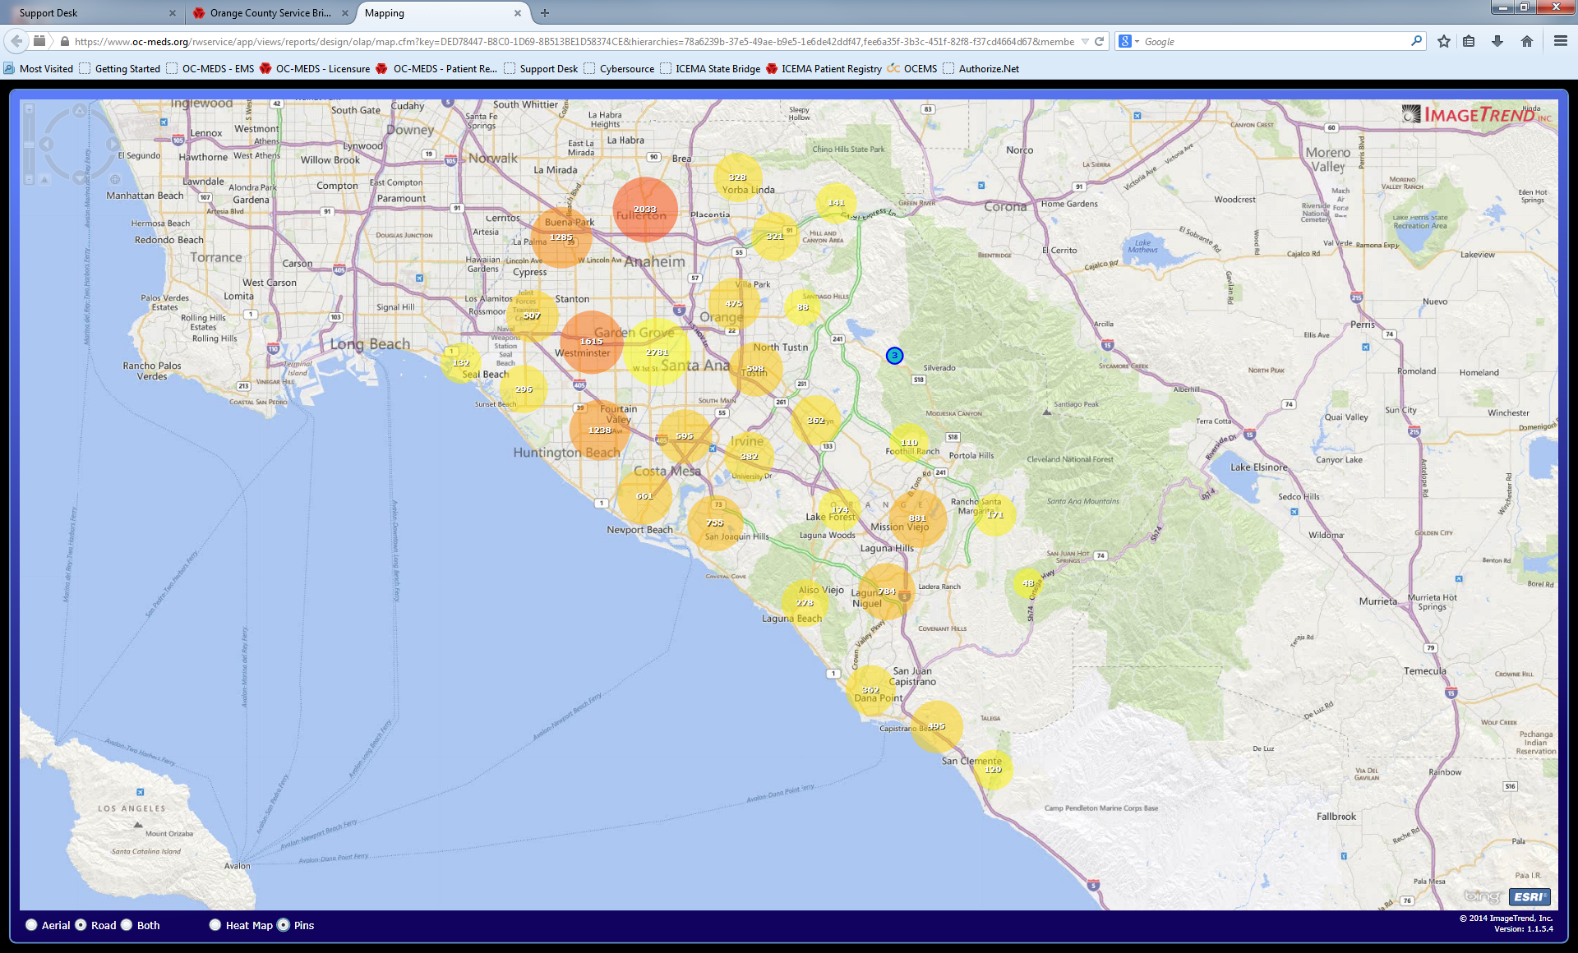
ePCR Usage (Count) Oct. 2014

Slide 10
If everything is working, why change?

Slide 11
If you want to make enemies, try to change something – Woodrow Wilson

Slide 12
Why Change?
  NEMSIS 3 is the new EMS data standard.
The current system (Field Bridge / Service Bridge) is based on NEMSIS 2 standards and “out going” technology.
The next generation system (Elite) is based on NEMSIS 3 standards and modern mobile computing platforms.
  NEMSIS 3 is compatible with Health Level 7 (HL7) data standards which are currently used by the rest of the health care industry. This will facilitate direct Health Information Exchange (HIE) with hospitals and health care systems.

Slide 13
Why Change?
The new system will support multiple computing platforms (iOS, Android, Mac OS, Windows)
Long Term Sustainability
  Device Costs
  System built from the ground up, making it more agile and more easily configurable.
  Technical infrastructure is more robust and consistent with modern computing environments.
  Will allow for sustainable / cost effective operations well into the future (10-15 years)
Did I mention HIE?

Slide 14

Benefits of HIE for EMS
Real time availability of EMS PCR at ED
EMS record available in hospital EMR
Patient outcome data accessible and searchable to EMS administrators via HIE.
Patient History, Allergies, Meds searchable via ePCR.
Bi-directional data exchange to facilitate “one patient – one record”

Slide 15

Notes:
NEMSIS 3 is so different from NEMSIS 2 that the data can’t be stored in the same database,
A new NEMSIS 3 system will have to be implemented alongside the existing NEMSIS 2 system.
Implementing this for a system as large as Orange County has many operational implications that have to be thoroughly considered and managed.

Slide 16
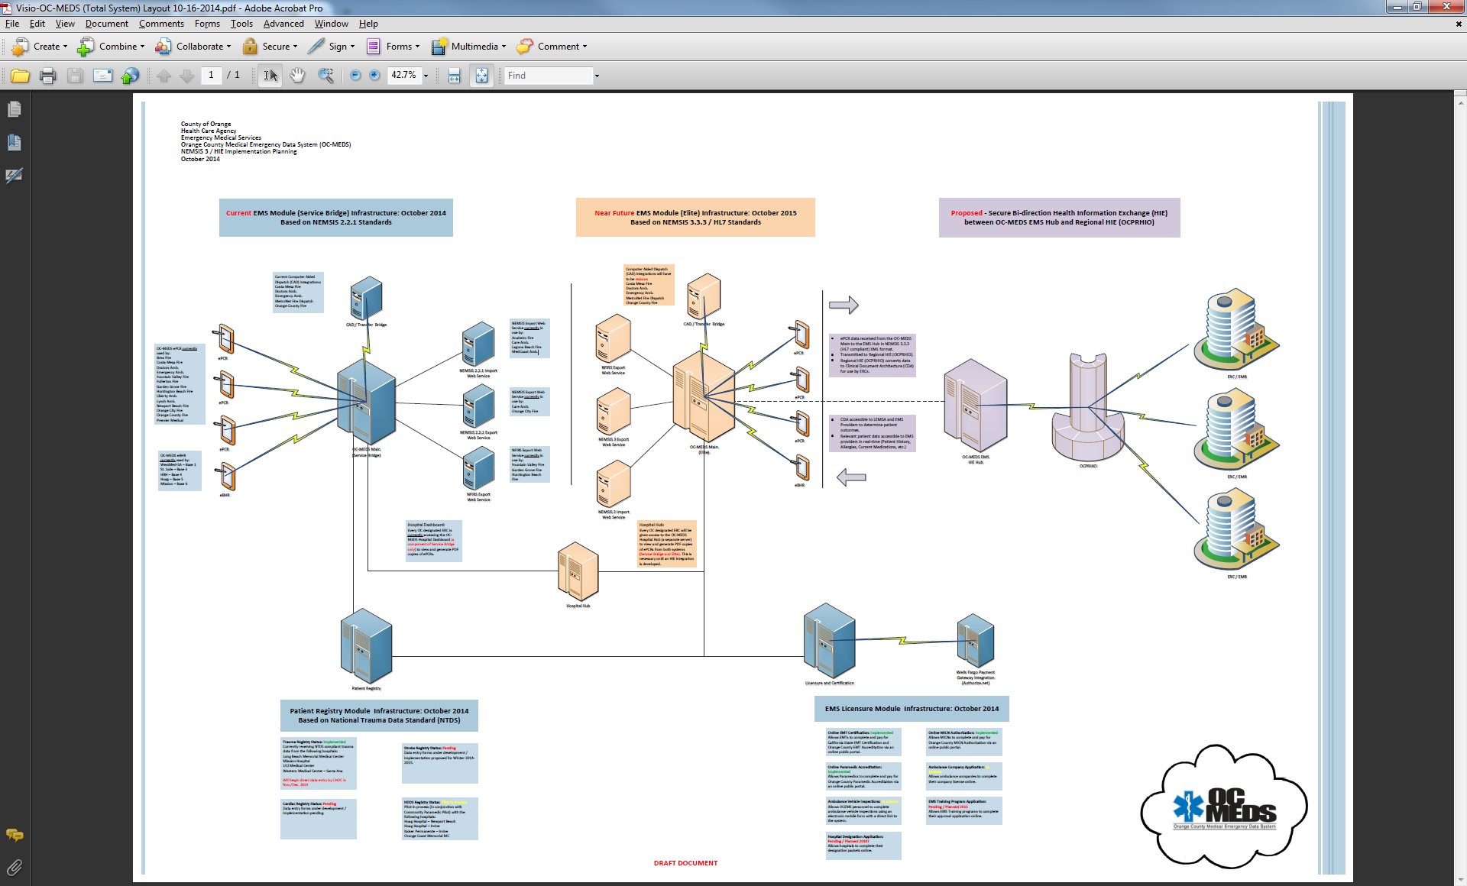
Notes:
This is what the system will look like as we move into the future.
Everything in blue is our current technical infrastructure including our ePCR, eBHR, Patient Registry, and Licensure / Certification Systems.
Everything in peach is the infrastructure that will be needed to implement NEMSIS 3.
Everything in purple is proposed infrastructure for a future integration with our regional HIE (OCPRHIO).

Slide 17
“Study the past if you would define the future.”
― Confucius
How do we make this happen?

Slide 18
How do we make this happen?
Vendor (ImageTrend) delivers NEMSIS 3 Software.
Multiagency / Multidisciplinary collaboration and planning.
Draft new policies and data lists.
Configure software to meet local “OC” needs.
Consider next round of tablets.
Testing / Training
Structured “Go-Live” Roll-out

Slide 19
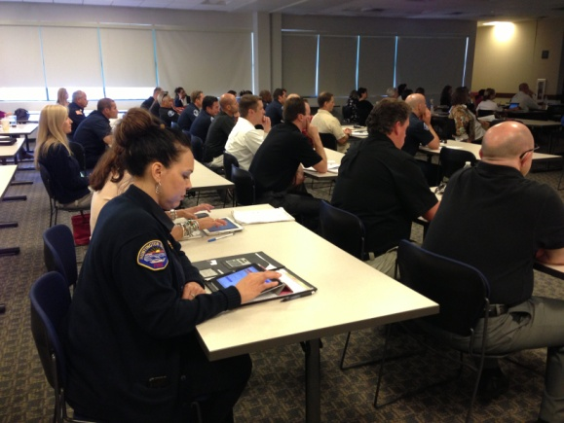
Collaboration
Form working groups comprised of EMS providers and hospitals to help shape where the system goes.
  Considers the operational and business needs of EMS system stakeholders.
  Ensures the data system is designed to meet the needs of EMS system as a whole.
  Encourages long term community support.

Slide 20
Grants
Public Health Emergency Preparedness
  $268,000
  Purpose: Implement HIE capabilities
Federal Block Grant
  $75,000
  Purpose: Purchase tablets to support NEMSIS 3 training and transition

Slide 21
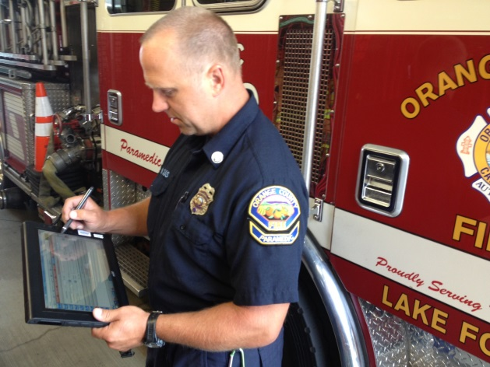
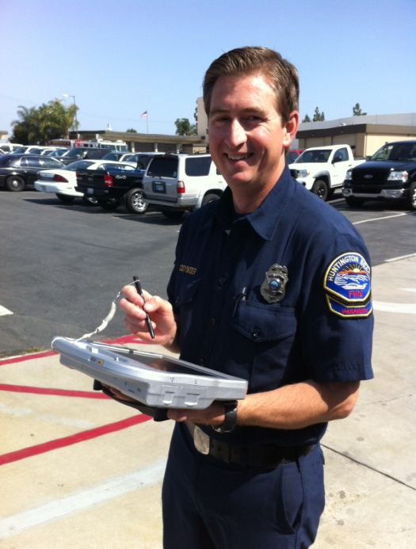
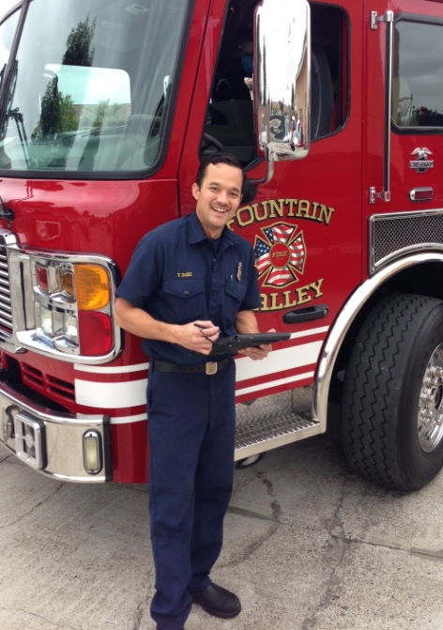
Super Users / System Testing
Notes:
A handful of dedicated users at each provider agency is absolutely essential to a successful rollout.
Best practices adopted by these “super users” helps to create good habits and a positive culture.
Remember, the field personnel are your data source. Their documentation becomes your data.

Slide 22
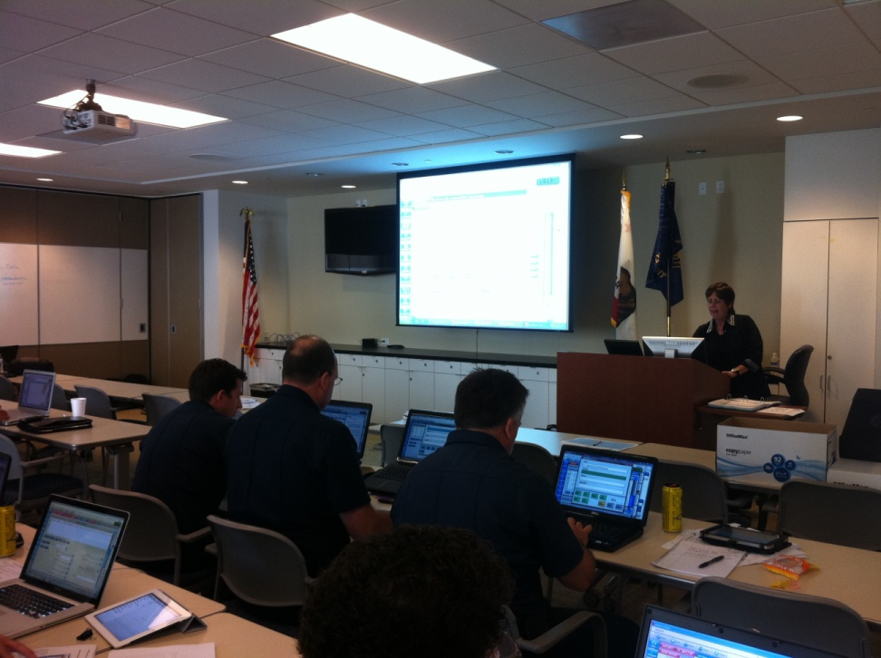
Staff Training
Hired contractor to provide set up and implementation assistance.
Provide “Train the trainer” courses and on site training opportunities for EMS providers, base hospitals, and receiving hospitals.
Develop custom user guides and training materials which are specific to Orange County – make guides available for download on the OCEMS website.
Use “Super Users” to champion the transition at the user level and help ensure best practices are adopted.

Slide 23
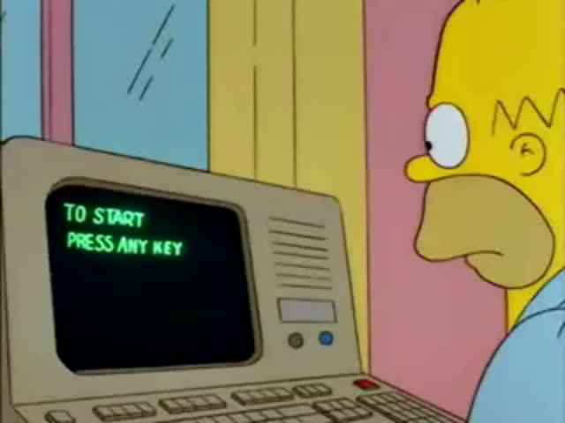
Staff Training

Slide 24
Structured “Go Live”
No matter what we do, there will be a time when we have some users on the NEMSIS 2 system and others on the NEMSIS 3 system.
  Affects unit to unit field ePCR transfers.
  Affects availability of PCR for hospitals.
  Affects accessibility of posted PCRs by provider agencies.
  Affects the ability to generate data reports through report writer.

Slide 25
Structured “Go Live”
To help minimize these affects, it’ll be best to structure the “Go Live:
  By geographic region?
  By agency?
Agencies that frequently work together should plan to make the change at or about the same time to minimize compatibility issues.

Slide 27
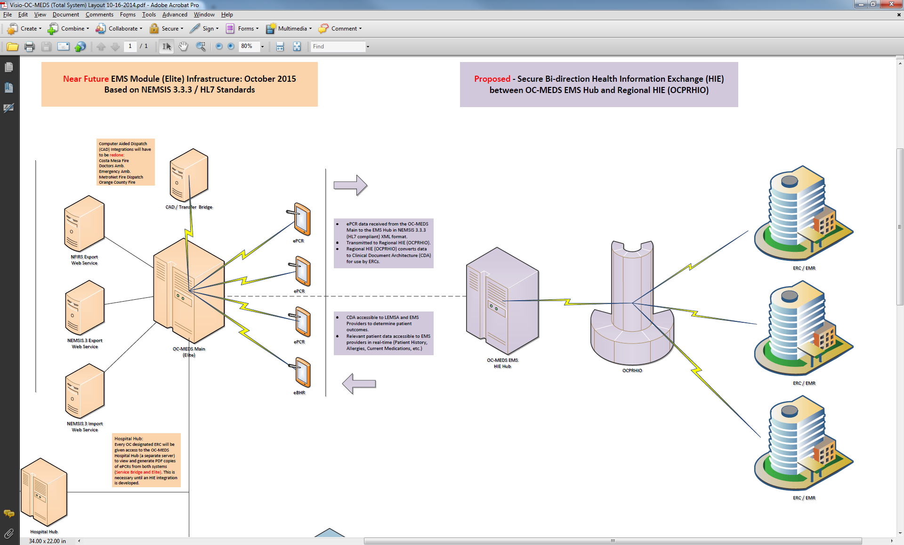
Notes:
Once the NEMSIS 3 system is implemented, we will be in a position to integrate with our regional HIE.

Slide 28
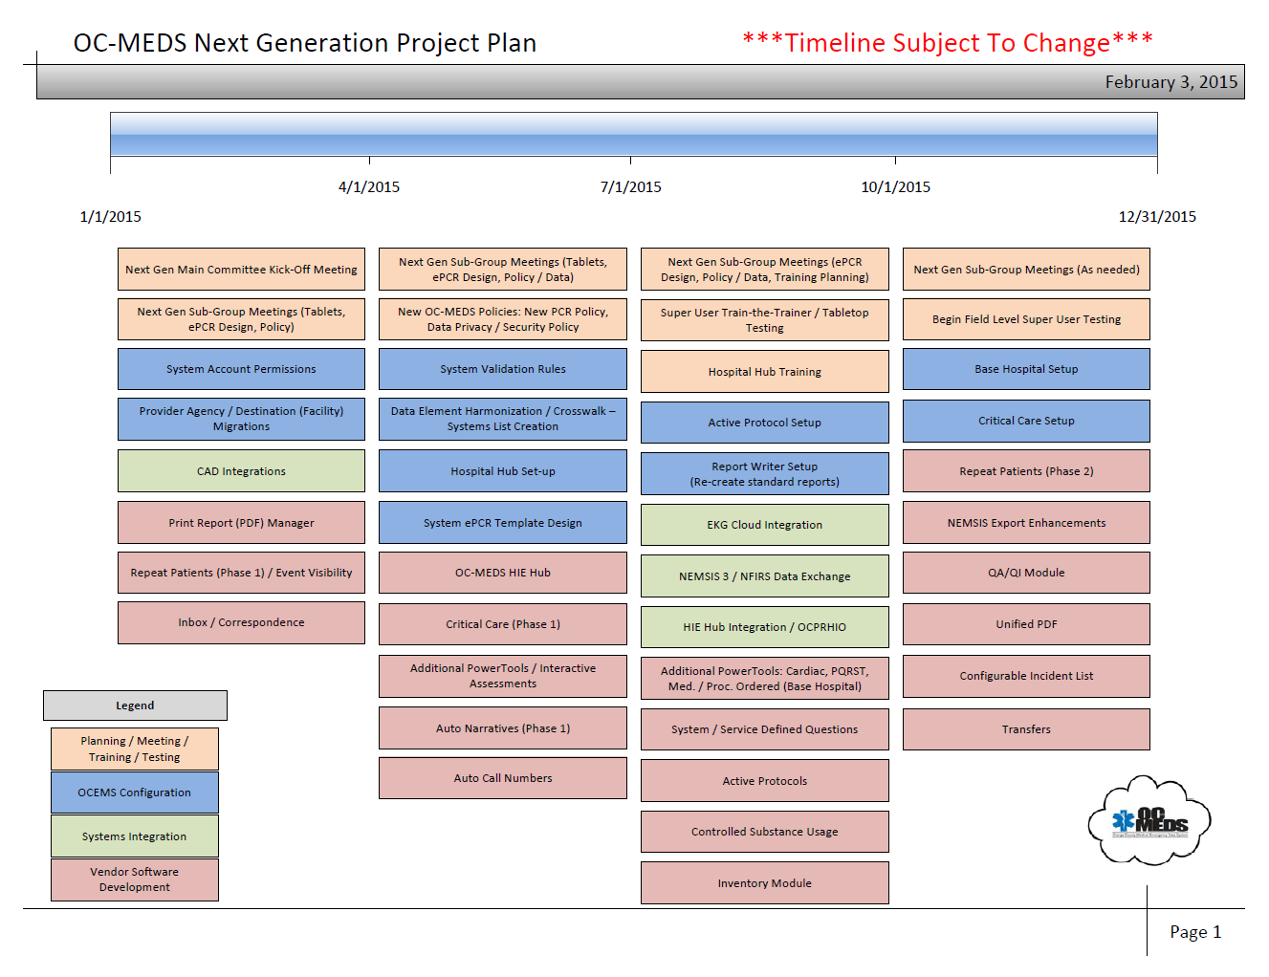

Slide 29
Thank you for listening
Questions?

