Slide 1
Best Practices
How do I do it Correctly…

Slide 2
While Moving Forward
How do I transition on the fly…While riding a bike don’t stop peddling

Slide 3
Keynote Presentations
IT
(Translating iOS from Windows perspective)
Brass
(Impact on People, Organization, Budget)
How To Pull this off
(CheckList)

Slide 4
Keynote Presentations
IT
(Translating iOS from Windows perspective)
Brass
(Impact on People, Organization, Budget)
How To Pull this off
(CheckList)

Slide 5
Myths
I must use a credit card to create an AppleID?
All Apps must come from or be submitted to the Apple iTunes Store?
I can only “supervise” a device through USB & Apple Configurator software?
I can only use Apple Configurator or an MDM not both?
Notes:
You can create an AppleID without a credit card. You must have a unique email address for each AppleID you create, however you can use one email address and multiple alaises to that same address.
Apps need NOT be submitted to the Apple App Store, you can get an app emailed to you or purchase it directly from a developer or create your own.
Supervise mode is the most control you can get, using the service called the “Device Enrollment Program” you can force the iPad or iPhone to belong to your MDM and also turn on “supervise” mode, prior to DEP you had to us Apple Configurator over a USB cable to do this.
You can use Apple Configurator and and MDM together which is a good combination however Apple Configurator funtionality is being replaced by the DEP program and you don’t have to use a USB port with the DEP program a big advantage in large deployments.

Slide 6
Myths
I can buy Apple hardware from “any” place I want and “after” I buy it enroll it in the DEP Program?
I must use a credit card to purchase License codes and Redemption codes from the Volumn Purchse Program online store?
Notes:
You must buy hardware from a vendor that supports Apple’s DEP program or you units will not be able to prove there “chain of ownership” and thus show up in you DEP portal. You CAN NOT add a unit to your portal after if is purchased there is NO work around. This means you can enroll and mange a device that is not in your portal but the user can manually remove the MDM settings and become a “free agent device”. Your MDM will notify you of this free agent and you can call the use in however it is not as nice a feature as a full DEP controlled device.
You do not need a credit card to buy on the VPP store, you can use a PO to “charge up” the account and then subtract from that charge as you go. You coud use a credit card on the account it is not required any longer.

Slide 7
Terms (IT)
iOS
Operating System for iPhone & iPad & iPod Version 8.x (Free Upgrade) (compeditor are Android)
Encryption
Using Software Certificates and Keys the entire iOS file system is protected (Kerberos assisted in hardware that can’t be turned off) Each App and corresponding files are in contained in their own sandbox secure from other apps and files.
XML
EXtensible Markup Language (the entire OS is built on and respects the XML tags on the files. Combined with encryption keys the files are secure and the data within described so it works very quickly in mobile environments)

Slide 8
Terms (IT)
Apple Developer Program
You can sign up for this and preview releases of the iOS
FIPS 140-2
Government certifacation for security which iOS has
MDM - “Mobile Device Management”
Allows you to control and configure iOS devices, saves you sanity by allowing you to change and track devices over the air.

Slide 9
Major Decsions…
AppleID Strategy
MDM
App Deployment
Self Feed v. Force Feed

Slide 10
Major Decsions…
AppleID Strategy
MDM
App Deployment
Self Feed v. Force Feed
What is this?
Why should everyone have their own?
Do you want to administer them?
How will iOS 9 change AppleID’s in your department
Notes:
The AppleID can be thought of technically as a certificate/key that is unique to the AppleID and binds the AppleID to apps that are purchased so it is important however Apple is putting in place technologies in iOS 9 that lessen it’s importance so IT staffs can manage the devices without having to care about the AppleID. In iOS 9 you will be able on a DEP enrolled device to send and bind a paid for app to a device not the AppleID freeing you to allow the user to put in any AppleID.

Slide 11
AppleID
What is this?
Why should everyone have their own?
Do you want to administer them?
How will iOS 9 change AppleID’s in your Dept.
Notes:
It was important at one time for the IT staff to pass out the AppleID’s this way they could control the apps that were bound to those AppleID’s, it was also important because a user could turn on Location Services and then leave your organization. Without the password for the AppleID the location aware services could not be turned off, without contacting Apple, now with Supervise mode you can control those settings. The device must be enrolled in DEP bound to your MDM automatically and in supervised mode is never out of your control or out of your reach.

Slide 12
AppleID
What is this?
For a Free App it doesn’t mean much…
Affects your ability to update devices.
For a paid App it matters a lot.
For location services it matters a lot.
Notes:
Some organiztion put one AppleID on many devices this is not good because for free apps it works but for apps that are paid for it doesn’t scale. Also when you need to upgrade the device you have to give the password out so the updates can be allowed. In the case of location services it also matters. Very bad will cause you extra work.

Slide 13
AppleID
What is this?
Why should everyone have their own?
Notes:
As an IT group you want users to use there own AppleID so you don’t have to manage there passwords. The user having an AppleID on the device should not matter to you if you have DEP, an MDM to adminstrate them and Supervise mode if you need it. Always keep in mind if you give an app to a user with MDM and a License Key you can recall that app later.

Slide 14
AppleID
What is this?
Why should everyone have there own?
Do you want to administer them?
Notes:
Prior to iOS9 it might have been important to control AppleID’s which meant you had to keep a list of them and passwords, with iOS 9 and DEP AppleID’s are now not as important to controling the device, so you have to ask yourself why would I administrate them?
For a fire department the answer is probably yes…and this is why. Most Fire Departments assign the devices to a rig and the device is shared between multiple users. So assiging an AppleID to a device is probably pretty smart. Naming the AppleID something like “StationNumber-RigName-Number” is a strategy that allows you to use the name in other places like location tracking.
For a device that is not on a rig or shared say the commanders iPad which he takes to meetings and stays with him on his off days assigning it an AppleID doesn’t make sense. It would be smarter to let him create an AppleID and make the device personal. He might have lots of pictures on the device and that would work better.

Slide 15
AppleID
What is this?
Why should everyone have there own?
Do you want to administrate them?
How will iOS 9 change AppleID’s in your
Notes:
iOS 9 when combined with DEP will allow you to send apps directly to the device so the AppleID won’t matter. This will be one features that will lesson the need for control over the AppleID. The other is you will be able to put a device registared into DEP into “supervise” mode the most restrictive control over the device.

Slide 16
Major Decsions…
AppleID Strategy
MDM
App Deployment
Self Feed v. Force Feed
What is this?
Why you must have one?
Which one to get?
Notes:
MDM stands for Mobile Device Management it allows you change settings on you devices, push or remove apps, and generally control your devices wirelessly. It allows you to manage the devices and not have people bring there devices to you to be fixed, it scales you deployments. The MDM client in the devices CANNONT BE DISABLED OR TURNED OFF however the client connection can be cut if the device is not “supervised” or is not in DEP. You can “supervise” a device with Apple Configurator but that only works over USB meaning the device have to return to the Mac that controls them this is NOT good, a MUCH better thing to do is enroll them in DEP and use your MDM to put it into supervise mode.
www.enterpriseios.com has a list of MDM server can a comparison chart. MDM’s are sold in two ways one way is a cloud service which is easy to get started with the other is an on premise server you purchase and host on your own machine.
In both cases you registar with Apple and get a software certificate. That certificate is load into you MDM, it identifies you to Apple’s push notifacation service which world wide will find your devices and alert them to “phone home” to your MDM. This phone home service does not know what your MDM is going to do to the client it only finds the devices on whatever network they are on and tells them to phone home, this phone home feature can’t be disabled on the devices and no one can pretend to be you and force them to phone home because the certificate identifies only you no one else.

Slide 17
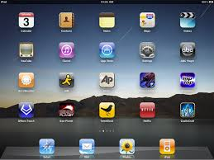
100 percent or less…
Control all areas of a device or just what you need.
Remove settings or apps.
Manage apps you send out pull them back if you need to.
iCloud, Gmail, Yahoo
Personal Settings
Photos
Apple ID
Music, Videos & Books
Apps
Notes:
iOS allows an MDM server to control it. The MDM server can wipe the entire device, just the part you administrate leaving the users personal data un-touched.
You could have three iPads with an eraser in front of each one looks like it erases part of one the entire one and almost none of the third.

Slide 18
Mobile Device Management
Process overview
Firewall
1
A Configuration Profile containing MDM server information is sent to the device.
User is presented with information on what will be managed and/or queried by the server.
2
User installs profile to opt-in to device being managed.
3
Device enrollment takes place as the profile is installed. The server validates device and allows access.
3rd Party MDM Server
Apple Push
Notification Service
4
Server sends push notification prompting device to check-in for tasks or queries.
5
Device connects directly to server over HTTPS. Server sends down commands or requests information.
Notes:
This anamation needs to be redone. reverse and have it go left to right, start with the iPad and a profile then the push notifacaton service and MEM equal distant to it, The slide shows the anamation next slide is my idea. put a rig with iPad like it’s on the rig
What you see here is an example of the process that takes place with MDM including the enrollment and ongoing management of iOS devices.
When a mobile device management server wants to communicate with iPhone and iPad, a silent notification is sent to the device prompting it to check in with the server. The device communicates with the server to see if there are tasks pending and responds with the appropriate actions. These tasks can include updating policies, providing requested device or network information, or removing settings and data.
Management functions are completed behind the scenes with no user interaction required. For example, if an IT department updates its VPN infrastructure, the mobile device management server can configure iPhone and iPad with new account information over the air. The next time VPN is used by the employee, the appropriate configuration is already in place, so the employee doesn’t need to call the help desk or manually modify settings.
Here is a step-by-step overview of the process:
1. The MDM information is sent to the device via Configuration Profile. This contains information that authenticates user/device to MDM server and Authenticates MDM server to device. When installed, the profile specifies what the MDM server can manage.
2. The Configuration Profile with MDM payload is installed. This can be done in the same way any Configuration Profile can be installed. (ie via Safari/Mail/iTunes/iPCU or via OTA Enrollment) The user sees the standard profile installation screen and is informed of everything will be managed and/or queried. Once accepted, user is no longer notified of changes.
3. Device enrollment take place as the profile is installed. An HTTPS Message is sent from the device to check in and the server decides if device is allowed based on IT defined requirements.
4. When the server wants to communicate with the device, it sends a push notification identifying itself. The device confirms it's associated with the server and checks-in for commands.
5. The device connects to the server over HTTPS after both sides authenticate. The server sends down command or makes query of the device. The device takes action or returns result to the server.

Slide 19
Mobile Device Management
Process overview
Fetch
2
Apple Push
Notification Service
Conversation
Find
3
1
3rd Party MDM Server
Notes:
This anamation needs to be redone. reverse and have it go left to right, start with the iPad and a profile then the push notifacaton service and MEM equal distant to it, The slide shows the anamation next slide is my idea. put a rig with iPad like it’s on the rig
What you see here is an example of the process that takes place with MDM including the enrollment and ongoing management of iOS devices.
When a mobile device management server wants to communicate with iPhone and iPad, a silent notification is sent to the device prompting it to check in with the server. The device communicates with the server to see if there are tasks pending and responds with the appropriate actions. These tasks can include updating policies, providing requested device or network information, or removing settings and data.
Management functions are completed behind the scenes with no user interaction required. For example, if an IT department updates its VPN infrastructure, the mobile device management server can configure iPhone and iPad with new account information over the air. The next time VPN is used by the employee, the appropriate configuration is already in place, so the employee doesn’t need to call the help desk or manually modify settings.
Here is a step-by-step overview of the process:
1. The MDM information is sent to the device via Configuration Profile. This contains information that authenticates user/device to MDM server and Authenticates MDM server to device. When installed, the profile specifies what the MDM server can manage.
2. The Configuration Profile with MDM payload is installed. This can be done in the same way any Configuration Profile can be installed. (ie via Safari/Mail/iTunes/iPCU or via OTA Enrollment) The user sees the standard profile installation screen and is informed of everything will be managed and/or queried. Once accepted, user is no longer notified of changes.
3. Device enrollment take place as the profile is installed. An HTTPS Message is sent from the device to check in and the server decides if device is allowed based on IT defined requirements.
4. When the server wants to communicate with the device, it sends a push notification identifying itself. The device confirms it's associated with the server and checks-in for commands.
5. The device connects to the server over HTTPS after both sides authenticate. The server sends down command or makes query of the device. The device takes action or returns result to the server.

Slide 20
MDM Capabilities
Install and remove Configuration Profiles
Query devices
Manage apps
Remote wipe and lock
Clear passcode
Notes:
Tweek graphic of fireman with iPad
When a device is managed, it can be administered by the mobile device management server through a set of specific actions.
Configuration and Provisioning Profiles
To configure devices and provision in-house applications, mobile device management servers can add and remove Configuration Profiles and Application Provisioning Profiles remotely.
Query devices
Query the device for a variety of attributes.
Manage apps
An MDM server can manage third-party apps from the App Store, as well as enterprise in-house applications. The server can remove managed apps and their associated data on demand or specify whether the apps are removed when the MDM profile is removed.
Remote lock
The server locks the iPhone and requires the device passcode to unlock it.
Remote wipe
A mobile device management server can remotely wipe an iPhone. This will permanently delete all media and data on the iPhone, restoring it to factory settings.
Clear passcode
This action temporarily removes the device passcode for users who have forgotten it. If the device has a policy requiring a passcode, the user will be required to create a new one.

Slide 21
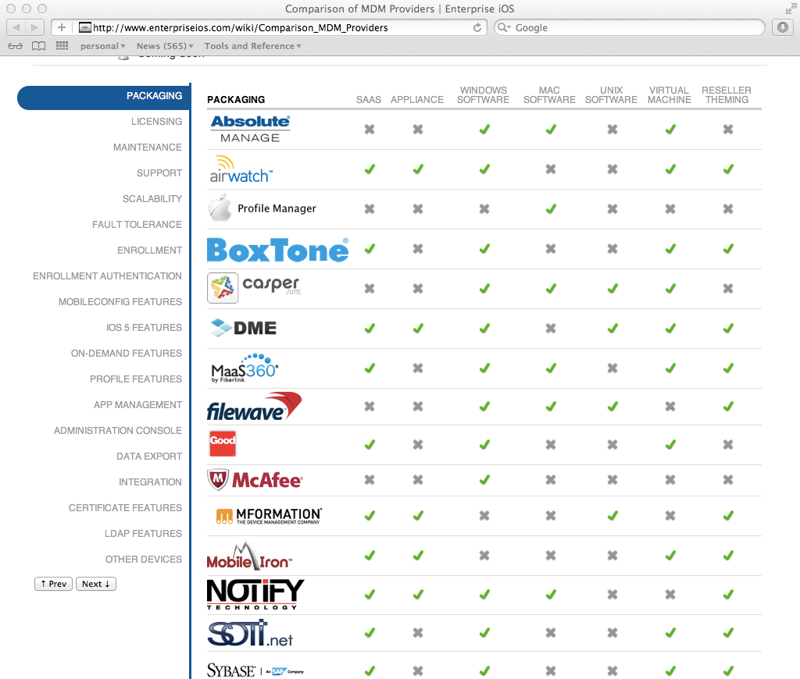
MDM Server
IT Management
IT Resources
Pick a Vendor, Strategy, Process
enterpriseios.com
Notes:
Apple doesn’t make a production MDM server it licenses the technology to others. Some MDM vendors have more ability than others most are availabe as a cloud service. the web site enterpriseios.com has a list of MDM vendors

Slide 22
Major Decsions…
AppleID Strategy
MDM
App Deployment
Self Feed v. Force Feed
What is this?
Behavior of Users is key
AD can help here
Notes:
When someone like your purchasing department buys license codes they come in a spreadsheet of numbers you upload to your MDM. You can then Push or Pull those license codes to the clients you have enrolled in your MDM. You can also push apps, pushing free apps from the store is easy paid apps you need a code. Apps that are not on the store you might get directly from a developer since they don’t come from the store the user might have to click a “trust app” before they can use the app first time but there isn’t any real difference after that.
You can setup apps to be pushed or pulled to devies and it’s important to realize the difference. One option is to PUSH the apps, which means they will appear on the devices however the users will then expect you to push apps in the future setting you up to be feeding the apps.
An alternative which is quite popular is to setup an internal app store, this a a web store which almost all MDM servers can create that allows you to let the users look at a controled list of apps the can choose to download. How can you control which users see what apps on this internal store? You can connect your MDM to AD from Microsoft and when they go to this internal store they are asked for there AD login and password. In this way you can group the users and only show one group of users one set of apps and a different group another set of apps.
The MDM hands out license codes so the internal store can do that also as user download the apps the MDM will count down the licenses used. This combination of license codes being handed out and using AD is very powerful for setting up an environment where users are not dependant upon you for installing apps, creates a feeling of control for the users but limits them to the apps you have on your internal store, extremely helpful when trying to determine which of a number of trial apps you want to use.

Slide 23
Distribute and Manage Apps
Managed distribution with MDM
Retain full ownership of apps
Assign, revoke, and reassign apps
Notes:
The MDM can distribute Licens codes, which can be revolked say when a user retires and you can pull back the license and re-use it someplace else.

Slide 24
Inernal Store
MDM serving up apps in custom store
Notes:
Tweek graphic and refer to cheat sheet I’m making.

Slide 25
Zero-touch MDM Enrollment
MDM enrollment automated during setup
MDM can be locked
IT does not need to touch each device
Automatic re-enrollment if device is reset
Notes:
Tweek graphic
It is now possible with DEP to do the following.
Sign up for a free DEP account, See devices that your department ownes if you Apple reseller is also signed up for DEP, have the devices still in the shrink wrap container never used, Assigne them in your DEP web portal to your MDM, Have the MDM auto configure them when the user opens them up, which means assign them apps, settings, email accounts, web clips, VPN settings and the like. We call this zero touch and it means you don’t have to set the device up for them at all no imaging.

Slide 26
Get Custom B2B Apps for iOS
Distributed privately through VPP store
Tailored for your business
Built for you by a third-party
Reviewed by Apple
Notes:
In the case of the county they might distribute an app.. Tweek graphic.
Customers who participate in the Volume Purchase Program can collaborate with developers on custom B2B apps, then securely and privately purchase those apps through the program.
Custom B2B apps are tailored for your business. They are built just for you by third-party developers and business partners, so they’re really unique for your business. They can address a specific business process, integrate with a unique back-office environment, or deliver a custom interface for your users.
Apple will continue to review these apps, just as apps on the App Store are reviewed to ensure they’ve been technically verified, tested for optimal performance, and checked to ensure a quality user experience (no crashing, malware, etc.).
The key to making this software distribution method possible is through the Volume Purchase Program.

Slide 27
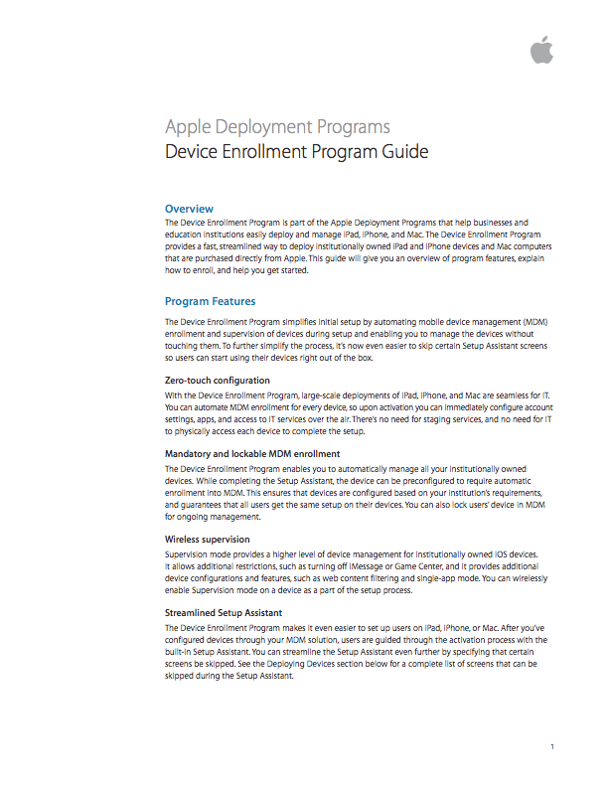
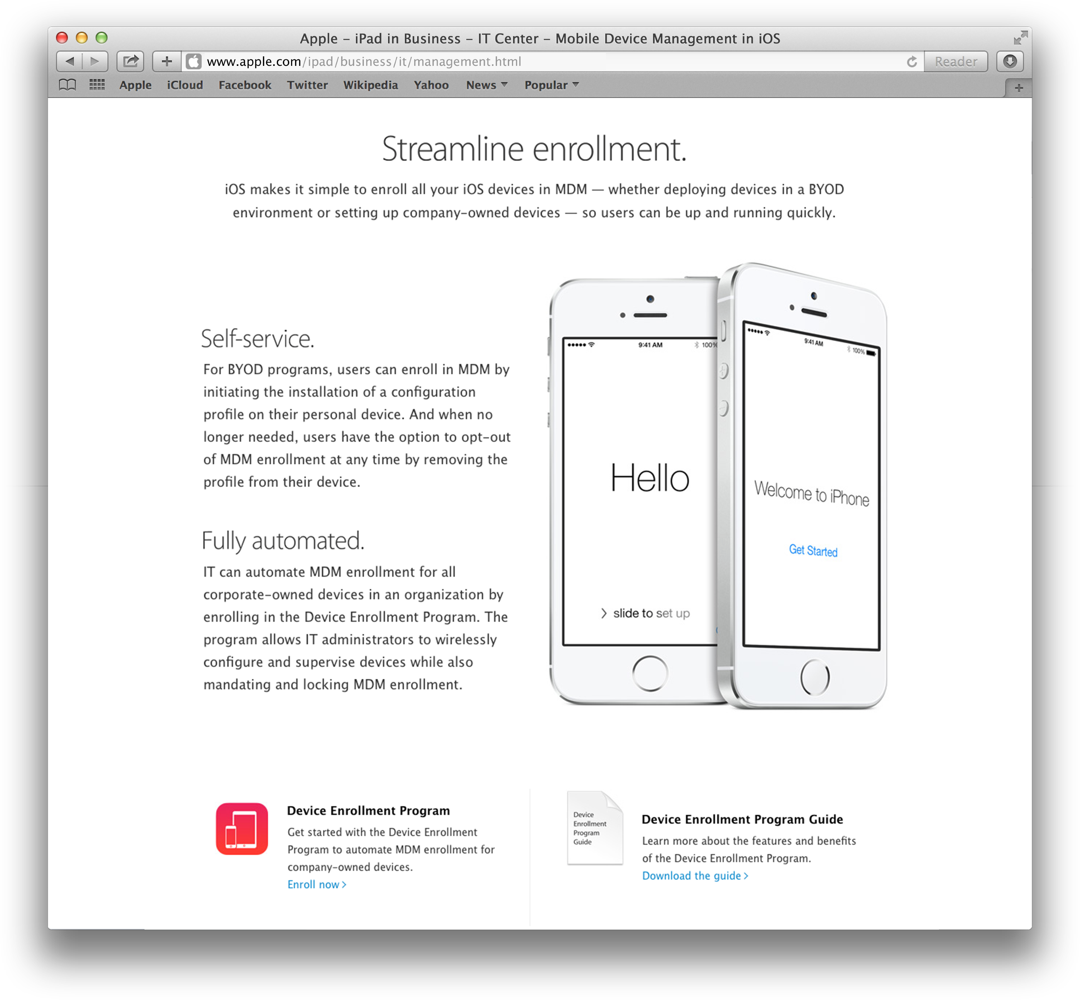
Program Resources
The new IT website
apple.com/ipad/business/it/management
Program Guide
Notes:
Helpful guides to read
For more information about the Device Enrollment Program, go to the Apple website and visit the management page in the IT Center. A program guide is also available to download from the website, providing additional information about the program and on how to enroll.
There are many resources available to you for more information.

Slide 28
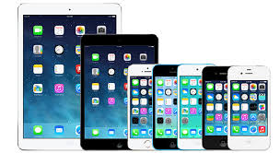
Device Enrollment Program
Zero-touch MDM enrollment
Wireless supervision
Streamlined Setup Assistant
Mandatory MDM enrollment during setup
Non-removable MDM
Notes:
Tweek graphic
The Device Enrollment Program (DEP) provides a fast, streamlined way to deploy all your company-owned devices
Devices MUST be enrolled in this program by the reseller you can never assign a device to you DEP program after it is bought only the reseller can do this so:
1. Only buy from reseller who participate in the program.
2. You might have older devies that are not able to be in DEP, this means you can manage them with the MDM but not “lock” them to your MDM.
3. If your department at some future date wants to release the devices and say donate them to someone outside the department they can do that by releasing them but they can’t be “captured” by someone else they would be considered a personal purchase device.

Slide 29
iOS 9…Fall
iOS 9 implications for distribution of apps for your organization…
Notes:
This involves money who is paying for the apps matters, the MDM can provide full audits of who has the apps use it for this purpose and the purchasing department will relax
Tweek graphic and refer to cheat sheet I’m making.

Slide 30
Conclusions…
Don’t Manage AppleID’s; use and Alais Strategy for email accounts
The MDM will allow you to manipulate XML data and keys on the devices; you don’t image in the old way
You can force uses to depend on you or train them to pull apps themselves
AppleID Strategy
MDM
App Deployment
Self Feed v. Force Feed
Notes:
AppleID’s you manage should be for devices that are shared, for example devices that stay on rigs. Giving out the password for this device is okay but if someone doesn’t know the password and needs it they need to easily be able to answer the challenge questions and reset the password. Managing AppleID’s on devices individuals use and are assigned perminately to individuals is work you probably don’t want to be involved with.

Slide 31
Get Started
iOS 9 Deployment Technical Reference
iBooks - https://itunes.apple.com/us/book/ios-deployment-reference/id917468024?mt=11
Online - https://help.apple.com/deployment/ios/
iOS 8 Deployment Technical Reference
iBook - https://itunes.apple.com/us/book/ios-deployment-reference/id917468024?mt=11
Online - https://help.apple.com/deployment/ios
PDF - http://manuals.info.apple.com/MANUALS/1000/MA1685/en_US/ios_deployment_reference.pdf
Device Enrollment Program (DEP) Guide
PDF - http://images.apple.com/business/docs/DEP_Business_Guide.pdf
Online - https://help.apple.com/deployment/programs/
Volume Purchase Program (VPP) Guide
http://images.apple.com/business/docs/VPP_Business_Guide.pdf
Online - https://help.apple.com/deployment/programs/
iOS Security White Paper
http://www.apple.com/business/docs/iOS_Security_Guide.pdf

