Slide 1
Orange County EMS
Data Compliance Summit
June 22nd, 2016

Slide 2
Objectives
Discuss specifics regarding new state laws and local policies that govern EMS Provider data submission requirements.
Definition of NEMSIS Compliance and the flow of EMS data.
How to become compliant and begin to submit data to OCEMS.
Introduction to the Orange County Medical Emergency Data System (OC-MEDS)
Questions and Answers.

Slide 3
What is NEMSIS?
The National EMS Information System
The National standard for EMS patient care documentation and data collection.
The current version is 3.4.0
URL: www.nemsis.org
Data submitted by the state.
The state is required to begin to submit EMS data to the federal government in NEMSIS 3 format no later than Jan. 1, 2017.

Slide 4
What is CEMSIS?
The California EMS Information System
The statewide standard for EMS patient care documentation and data collection.
Meets national and statewide data standards.
The current version is 3.4.0
URL: www.emsa.ca.gov/CEMSIS
Data submitted by the LEMSAs
Statewide compliance required by Jan. 1, 2017

Slide 5
What is OC-MEDS?
The Orange County Medical Emergency Data System.
The Orange County local standard and system for EMS patient care documentation and data collection.
Is compliant with the current version of NEMSIS and CEMSIS and includes additional data elements to meet the needs of the Orange County EMS System.
The current version is 3.4.0
URL: healthdisasteroc.org/ems/ocmed
Data submitted by EMS providers.
Countywide compliance required by Jan. 1, 2017

Slide 6
What is a PCRS?
Patient Care Reporting System (PCRS)
An electronic data system; or ePCR that allows an EMS provider to record and catalog patient care and transportation in real time at the patient bedside.
System must be compliant with federal, state, and local requirements.

Slide 7
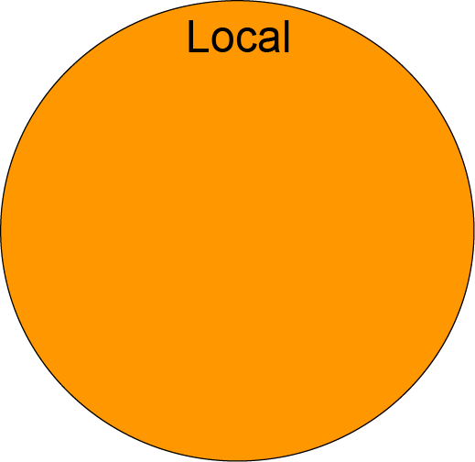
National / State / Local Data Standards

Slide 8
The flow of EMS Data
OC-MEDS
NEMSIS
EMS Provider ePCR
CEMSIS

Slide 9
Timeline – How we got here
Feb. 2015 – Countywide taskforce formed to plan for near future NEMSIS 3 requirements
Several sub-groups are formed including representatives from Ambulance Providers, Fire Departments, and Hospitals
Goal was to design and provide systems that met the needs of all EMS providers
Sub-groups included Equipment and Tablets, Template Design, and Data Dictionary.
Feb. 27, 2015 – AB 1129 Introduced in the State Assembly.
Mar. 2015 – OCEMS receives new NEMSIS 3 compliant software and begins configuration and system design.

Slide 10
Timeline – How we got here
Sept. 2015 – Local Sub-groups begin meeting
Sept. 30, 2015 – AB 1129 is signed in to law; to become effective as 1797.227 of the Health and Safety Code on Jan. 1, 2016.
Jan. 1, 2016 – Section 1797.227 of the Health and Safety Code becomes law. Mandates that all EMS providers utilize the NEMSIS 3 standard for patient care documentation.
Jan. 5, 2016 – State EMS Authority issues letter to clarify and restate new statewide NEMSIS 3 mandate.

Slide 11
Timeline – How we got here
Jan. 28, 2016 – OCEMS polls local ambulance providers to determine ePCR transition readiness.
Jan. 29, 2016 – New statewide NEMSIS 3 requirements announced and discussed at OC EMCC Meeting.
Feb. 3, 2016 – OCEMS issues letter to confirm statewide NEMSIS 3 mandate and state local transition efforts and deadlines.
Mar. 30, 2016 – Taskforce sub-groups complete their work. Results in new ePCR templates and 1st DRAFT of OC Data Dictionary.

Slide 12
Timeline – How we got here
April, 27 2016 – New data requirements discussed at Transportation Advisory Committee meeting.
April 29, 2016 – Statewide NEMSIS 3 mandate and Jan. 1, 2017 deadline restated at EMCC committee meeting.
May 1, 2016 – New / Updated data compliance policies (300.30 and 300.32) released and OC Data Dictionary (300.31) out for 50 Day Public Comment.

Slide 13
Timeline – How we got here
May 23, 2016 – Letters sent to all Orange County licensed Ambulance providers to announce data submission application process with June 15th, 2016 deadline.
May 31, 2016 – OCEMS conducts ePCR Administrator training for all EMS providers.
June 15, 2016 – Ambulance provider data submission application deadline. Received applications from all but three (3) providers.
June 19, 2016 – Data Dictionary Public Comment closes.
June 22, 2016 – Data Compliance Summit

Slide 14
Data Compliance State Laws and Local Policies
1797.227 (Health and Safety Code)
OCEMS Policies
300.30 – Establishes countywide data submission requirements
300.31 – (DRAFT) OC Data Dictionary
300.32 – Establishes countywide data submission process
720.60 – Mandates that all ambulance providers submit data no later than Jan. 1, 2017.

Slide 15
State Law and Directives
1797.227 – Effective Jan. 1, 2016
EMS providers shall:
Use an electronic health record (EHR) that is compliant with the current versions of the CEMSIS and NEMSIS standards and includes those data elements that are required by the local EMS agency.
Ensure their EHR can be integrated with the LEMSA.
The LEMSA can not mandate an EMS provider use a specific EHR system (unless required by contract executed before Jan. 1, 2016).

Slide 16
Local OC Policies
Policy 300.30 - Highlights
EMS providers shall:
Ensure that all PCRs are submitted to the OC-MEDS Hub immediately upon completion.
Submitted PCRs must comply with federal, state, and local data standards (Policy 300.31)
As of Jan. 2017, only submit data using the current version (v3.4.0) of NEMSIS.
May use the OC-MEDS Hub to meet requirements or may use own Patient Care Reporting System (PCRS).
If using own PCRS, system must be certified NEMSIS 3.4.0 compliant with the NEMSIS Technical Assistance Center.

Slide 17
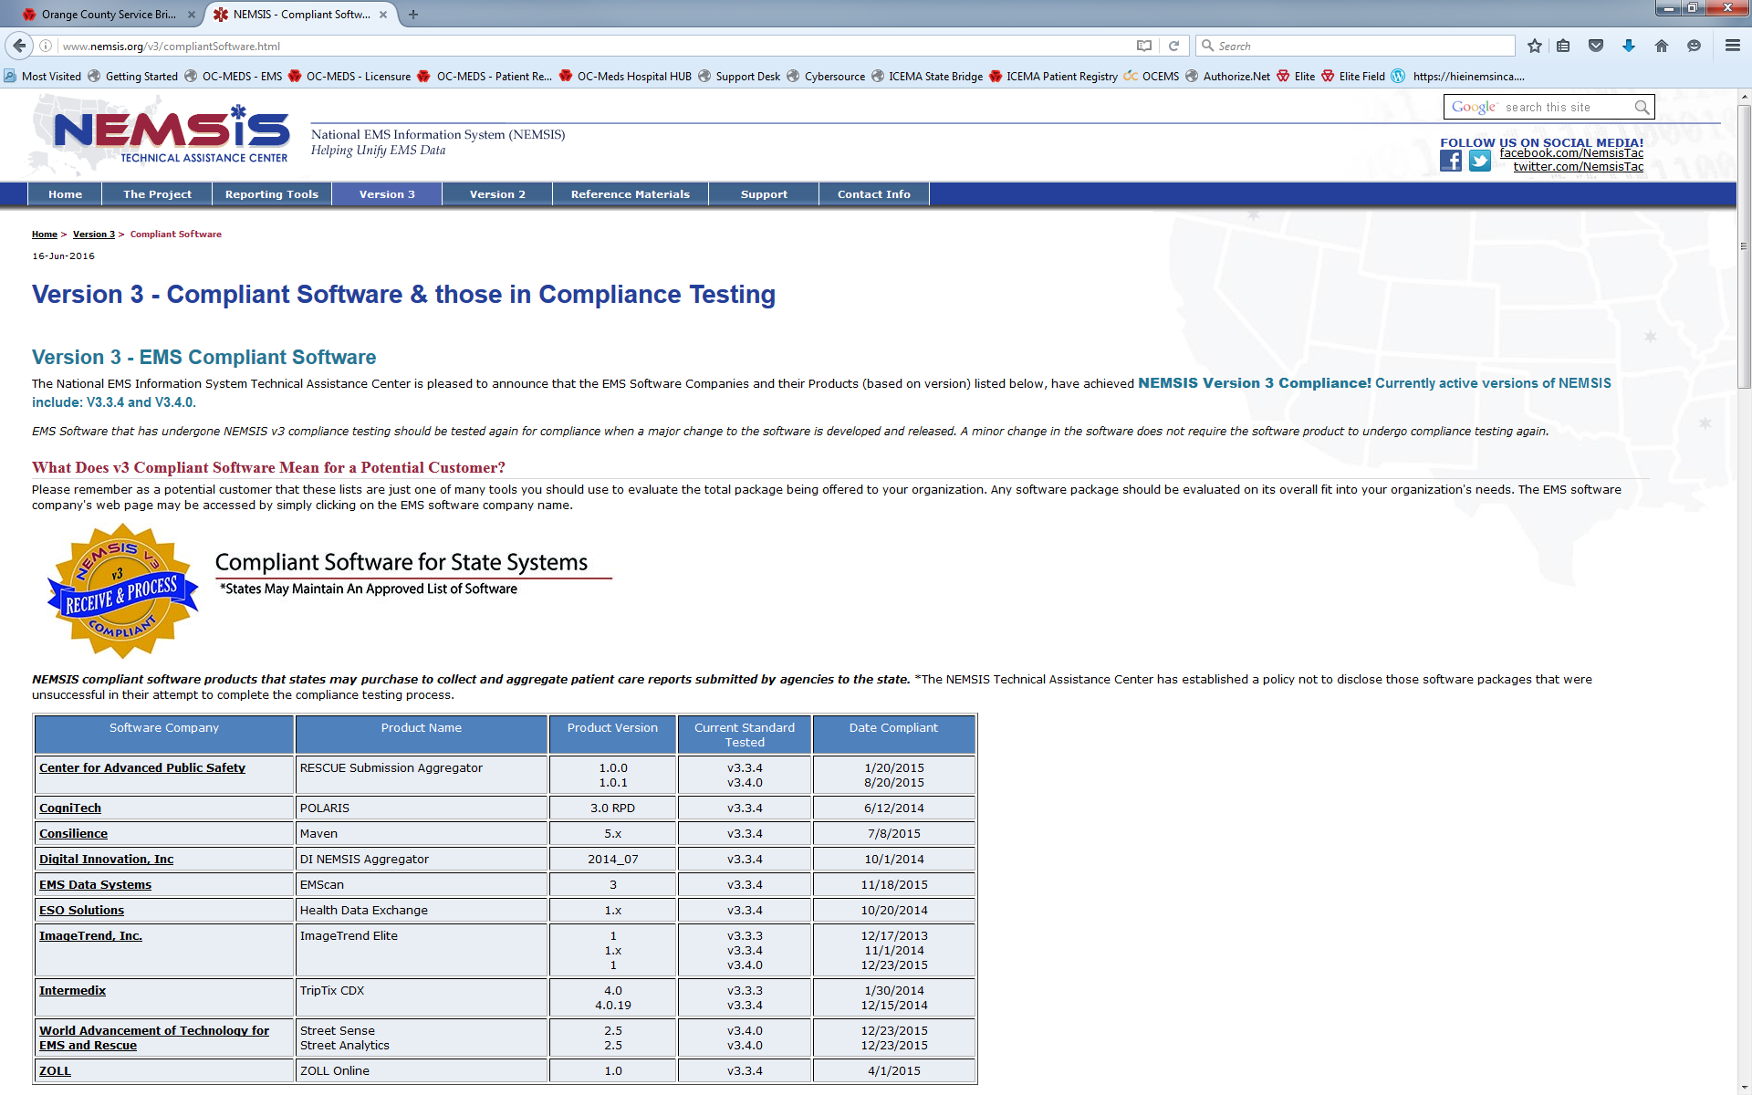
What is meant by certified compliant?
http://www.nemsis.org/v3/compliantSoftware.html

Slide 18
Local OC Policies
Policy 300.31 - Highlights
OC-MEDS Data Dictionary
Document currently a draft.
50 Day Public Comment ended on June 19, 2016.
Final version to be released soon.
Establishes the local EMS Data Standard that meets the needs of the Orange County EMS System.
Includes all federal and state data elements.
Includes additional data elements and field values that meet Orange County requirements.

Slide 19
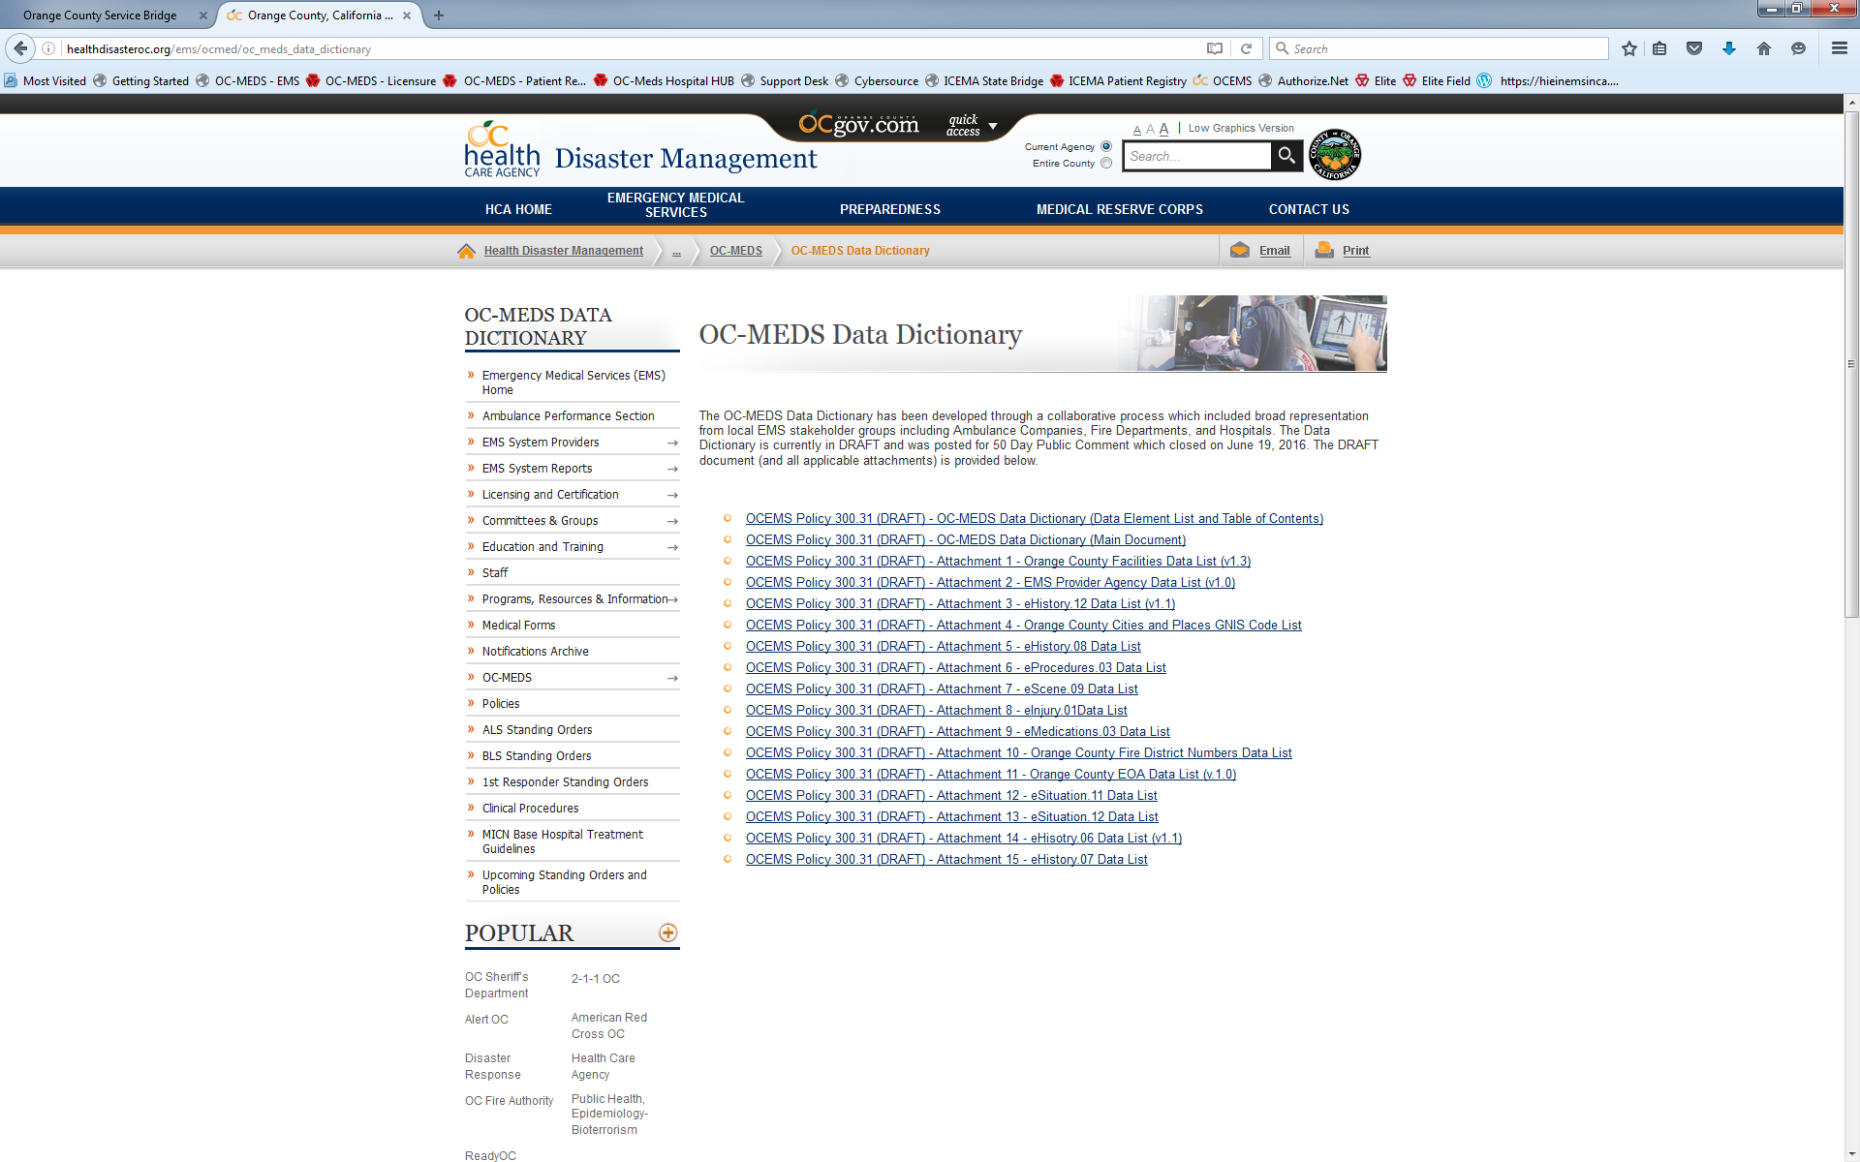
OC-MEDS Data Dictionary
http://healthdisasteroc.org/ems/ocmed/oc_meds_data_dictionary

Slide 20
Local OC Policies
Policy 300.32 - Highlights
Establishes a data submission process.
EMS Providers must submit an application to gain access to the OC-MEDS Hub.
Providers may choose to use the OC-MEDS Hub as their PCRS or may submit data to the OC-MEDS Hub live (via Web Service) from their own PCRS.
Non-emergency ambulance providers choosing to use the OC-MEDS Hub must demonstrate that at least 80% of their call volume originates within Orange County.
Providers choosing to use their own PCRS must demonstrate that their system is certified compliant with the current version (v3.4.0) of NEMSIS.

Slide 21
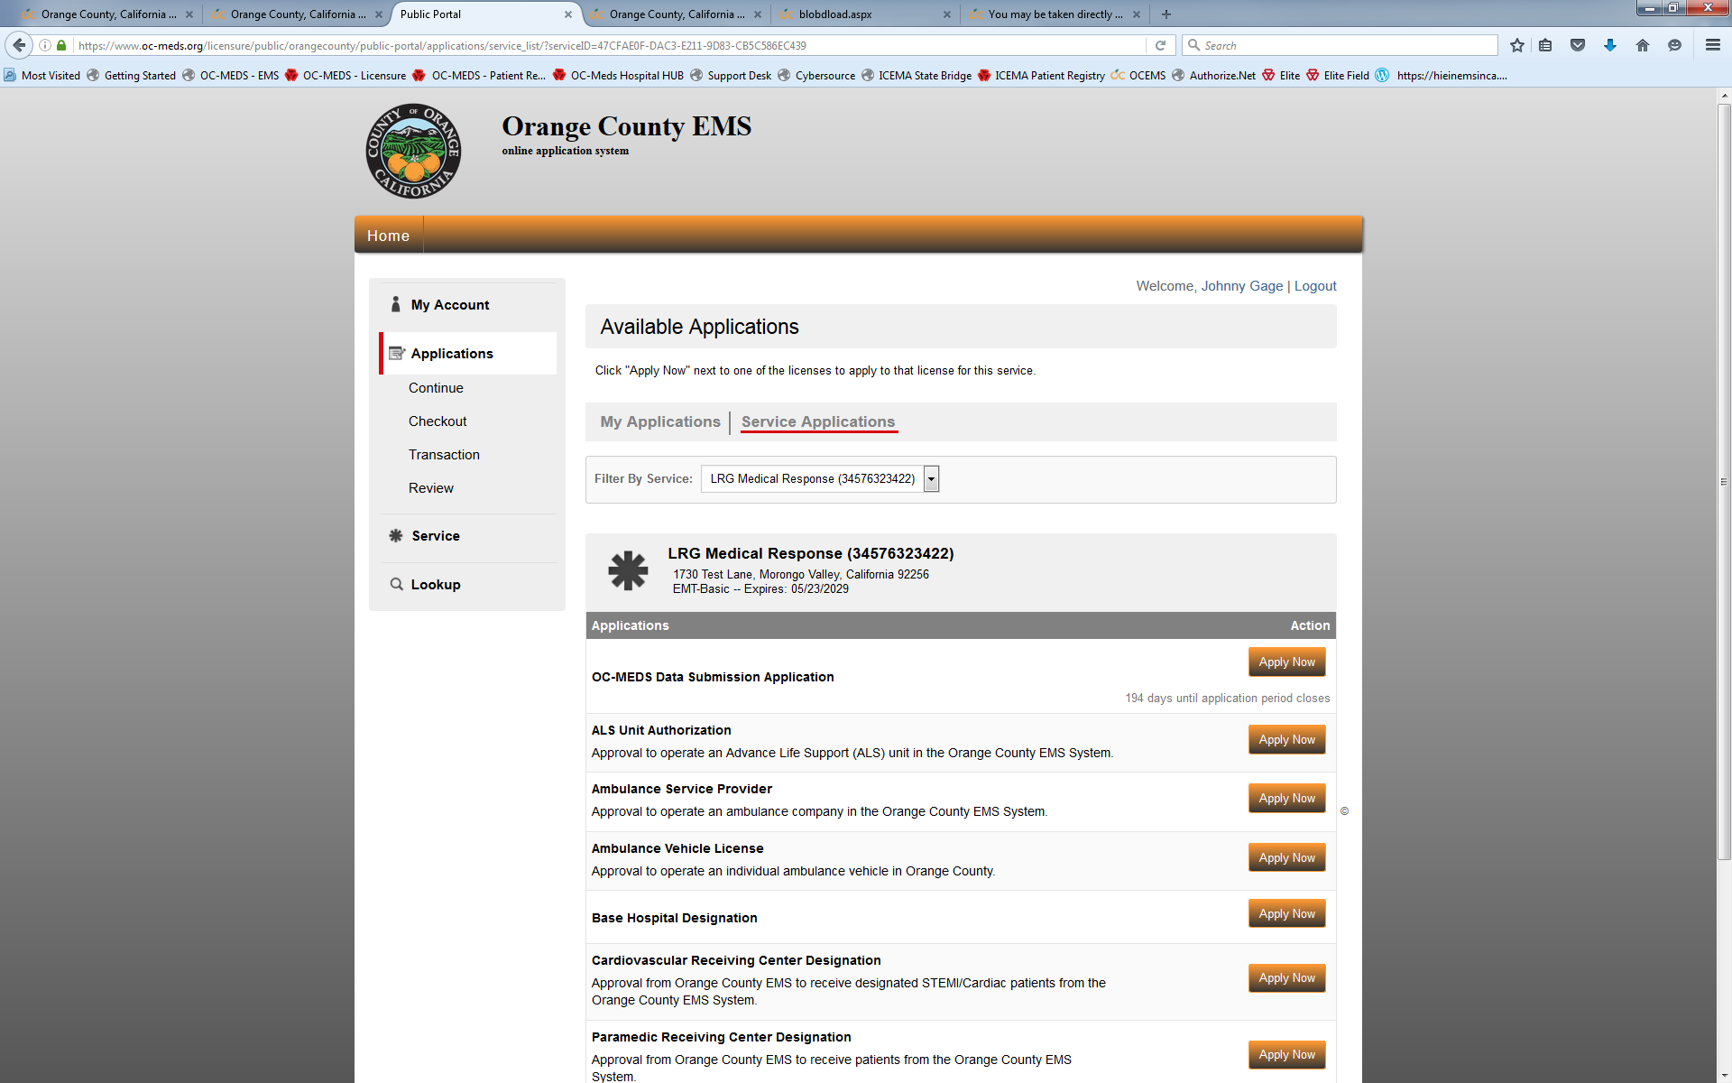
Data Submission Application
https://www.oc-meds.org/licensure/public/orangecounty/

Slide 22
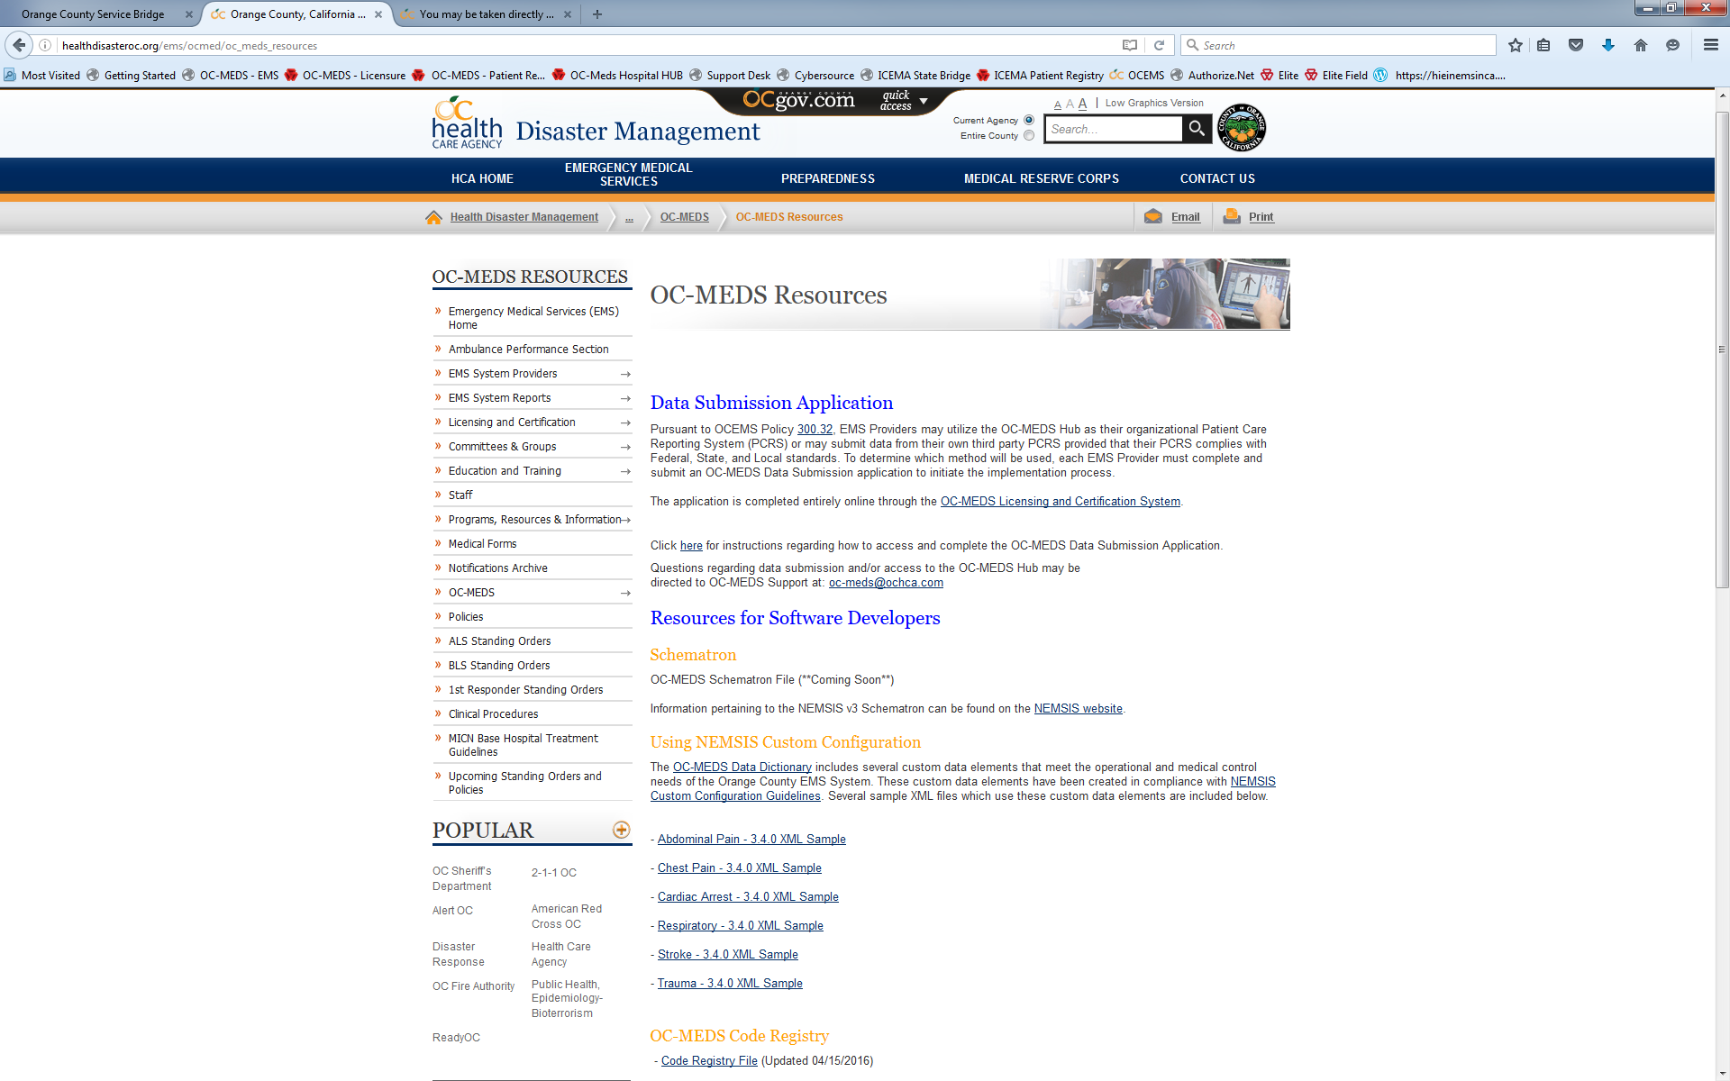
Resources for Software Developers
http://healthdisasteroc.org/ems/ocmed/oc_meds_resources

Slide 23
Local OC Policies
Policy 720.60 – Highlights
EMS Providers must complete and submit a PCR for every patient pursuant to Policy 300.30.
Non-emergency patient transports:
By Dec 31st, 2016 - Non-emergency ambulance providers must submit data from completed PCRs for every patient transported.
Providers shall use a PCRS that is certified compliant with the current version (v3.4.0) of NEMSIS.
Data shall be submitted in real-time or near real time following the incident.
“Near real time” is defined as : As soon as technologically possible.

Slide 25
Notes:
This is what the system will look like as we move into the future.
Everything in blue is our current technical infrastructure including our ePCR, eBHR, Patient Registry, and Licensure / Certification Systems.
Everything in peach is the infrastructure that will be needed to implement NEMSIS 3.
Everything in purple is proposed infrastructure for a future integration with our regional HIE (OCPRHIO).

Slide 26
For assistance, contact us at:
OC-MEDS@ochca.com

Slide 27
Questions???

