Slide 1
2025 Statewide Medical & Health Exercise Water Disruption
Tabletop Exercise
April 24, 2025

Slide 2
Welcome and Overview
Welcome
Name
Position
Agency/Organization
Optional: Icebreaker
Materials
Situation Manual
Feedback Form

Slide 3
Statewide Medical and Health Exercise Overview
The Statewide Medical Health Exercise (SWMHE) is an annual event designed to enhance the preparedness and response capabilities of the healthcare system.
The purpose of this exercise is to provide participants with an opportunity to evaluate current response concepts, plans, and capabilities in response to the scenario.

Slide 4
Exercise Goals
Exercise Goals
Test and validate policies, plans, procedures, training, equipment, and agreements
Clarify and train personnel in roles and responsibilities in emergency response and recovery
Improve interagency coordination
Identify gaps in resources and response plans
Strengthen relationships among all participating agencies
Meet various requirements from regulatory and accreditation agencies

Slide 5
Agenda
Time | Activity
8:30 AM ­– 9:00 AM | Registration Check-In
9:00 AM – 9:15 AM | Administration, Agenda, and Welcoming Remarks
9:15 AM – 10:00 AM | Module 1 Scenario, Module 1 Discussion Questions
10:00 AM – 10:45 AM | Module 2 Scenario Update, Module 2 Discussion Questions
10:45 AM – 10:50 AM | Break
10:50 AM – 11:30 AM | Hotwash / Debrief
11:50 AM – 12:00 PM | Closing Remarks
12:00 PM | Adjourn

Slide 6
Exercise Overview
Exercise Name | 2025 Orange County SWMHE Tabletop Exercise (TTX)
Exercise Dates | April 24, 2025
Scope | This TTX is planned for the Orange County Health Care Agency – Emergency Medical Services, healthcare coalition partners, healthcare facilities and organizations, and emergency response partners as part of the Statewide Medical and Health Exercise. This TTX will take place on April 24, 2025 from 9:00 AM to 12:00 PM at the [Insert Location].
PHEP Capabilities | Emergency Operations Coordination; Information Sharing; Emergency Public Information and Warning; Medical Surge.
HPP Capabilities | Health Care and Medical Response Coordination; Continuity of Health Care Service Delivery; Medical Surge.

Slide 7
Exercise Overview (Continued)
Objectives | [Each organization should select their appropriate objectives from the list in the situation manual and add anymore custom objectives applicable; and ensure the selected objectives align with the discussion questions used.]

Slide 8
Participants Roles and Responsibilities
Participant Roles & Responsibilities
Facilitators: Provides situation updates and moderate discussions
Players: Respond to situation presented based on current plans, policies, and procedures
Observers: Observe the discussion, but do not participate in moderated discussion
Evaluators/Note Taker: Observe and document player discussions

Slide 9
Assumptions and Artificialities
Assumptions
The exercise is conducted in a no-fault learning environment wherein capabilities, plans, systems, and processes will be evaluated
The exercise scenario is plausible, and events occur as they are presented
Artificialities
Impacts across the operational area
Some time lapses may be artificially used to achieve the exercise objectives

Slide 10
Exercise Evaluation
Exercise Evaluation
Participant Feedback Forms – Scan QR Code or complete a hard copy.
Hot Wash Notes –Immediately following the tabletop exercise, we will conduct a short discussion on strengths and areas for improvement.

Slide 11
Considerations When Responding to Discussion Questions
Will there be enough:
Staff?
Space?
Supplies & Equipment?
Special considerations:
Evacuations
Staffing Impacts
Available Water Resources
Responder Safety
Public Messaging
System? (i.e., patient tracking, messaging)

Slide 12
Module 1

Slide 13
Scenario
Water Contamination due to Criminal Activity
Officials have identified suspicious activities around key water infrastructure sites in Orange County.
An anonymous social media account has posted cryptic messages alluding to an attack on public utilities, heightening concerns of an orchestrated effort.
Over the past 72 hours, emergency departments across Orange County have seen a surge in patients.
The scope of the contamination is under investigation.
The Health Officer is currently considering implementing a Countywide “do not use” order.
Don’t Fight the Scenario!

Slide 14
Module 1 Discussion Questions
Based on the information provided, participate in the discussion concerning the issues raised in this module and identify any additional requirements, critical issues, decisions, and/or questions that should be addressed at this time.
[Each organization should select their appropriate discussion questions from the list in the situation manual and add anymore custom questions applicable; and ensure the selected questions align with the selected objectives.]

Slide 15
Module 2

Slide 16
Scenario Update
The County Health Officer has implemented a “do not use” order for the entire county.
It is unclear how long this advisory will be in place.
The Water Emergency Response Organization is working with all potable water districts to assess the impacts of each region. The current severity of the impact is unknow.
The County EMS AOC has been fully activated to support.

Slide 17
Module 2 Discussion Questions
Based on the information provided, participate in the discussion concerning the issues raised in this module and identify any additional requirements, critical issues, decisions, and/or questions that should be addressed at this time.
[Each organization should select their appropriate discussion questions from the list in the situation manual and add anymore custom questions applicable; and ensure the selected questions align with the selected objectives.]

Slide 18
Hotwash

Slide 19
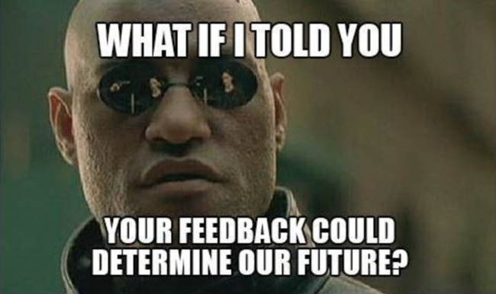
Exercise Hot Wash
Provide two strengths that you observed during today’s discussion
Provide two areas for improvements that you observed during today’s discussion.

Slide 20
Questions?

Slide 21
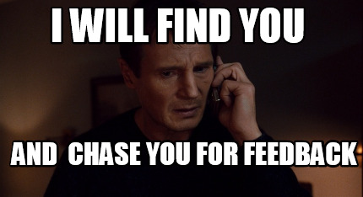
Participant Feedback Forms
Exercise Evaluation
Participant Feedback Forms: Scan the QR Code or complete a hard copy of the evaluation.

Slide 22
Thank You for your participation!

