Slide 1
5150/5585
Lanterman-Petris-Short (LPS) Outpatient Designation
Supplementary Materials
Revised 04/06/2026

Slide 2
5150/5585 Supplementary Material Instructions
The following slides are supplementary materials regarding:
  History and Intent of the Lanterman- Petris- Short (LPS) Act
  Review of Welfare and Institution Code (WIC) 5150 and 5585 and changes made over time
  Role of Patients’ Rights Advocacy Services (PRAS)
  Guidance on professional writing in context of 5150/5585 evaluations
QMS created this slide deck to balance the in-person training more on clinical applications and writing skills vs. historical and background information as presented here

Slide 3
History of Lanterman-Petris-Short (LPS) Act
Section 1

Slide 4
The LPS Act
The California LPS Act set precedent for modern mental health commitment procedures in the United States.
The LPS Act states that persons with a mental health disorder have the same legal rights and responsibilities that are guaranteed to all other persons by the Federal Constitution and federal laws as well as the Constitution and laws of the State of California.

Slide 5
The Intent of the LPS Act (WIC 5001)
End the inappropriate, indefinite, and involuntary commitment of persons with mental health disorders, people with developmental disabilities, and persons impaired by chronic alcoholism.
Provide prompt psychiatric evaluation and treatment of persons with serious mental health disorders or impaired by chronic alcoholism.
Provide individualized treatment, supervision, and placement services by a conservatorship program for persons who are gravely disabled.
Protect persons with mental health disorders and developmental disabilities from criminal acts.

Slide 6
LPS Developments Over the Years
WIC 5585 developed in 1988 – special needs of minors vs. adults
AB 4642 in 1998 – changed Grave Disability so it accounts for minors, “…even though provided to the minor by others”
  Child hospitalized under 5585 must have an Aftercare Plan developed before release from hospital
AB 1424 in 2001
  Broadened information required to be included during 5150/5585 process and finding probable cause
    Medical and psychiatric records must be reviewed and considered in historical course, if available
    Relevant info provided by family or the individual about historical course
    Medication history must also be considered
    Prohibits health plans, insurance, etc. from considering whether inpatient admission was voluntary or involuntary for purpose of determining reimbursement eligibility
AB 2275
  Additional due process protections during 5150/5585
SB 43- expands the definition of Grave Disability to include Severe substance use disorder

Slide 7
Review of welfare & institution code (WIC) 5150 and 5585
Section 2

Slide 8
WIC 5150 Overview
5150: Detain and transport to an LPS facility
5151: Assessment to determine the appropriateness of the involuntary detention
5152: Admission involuntarily, pursuant to the above

Slide 9
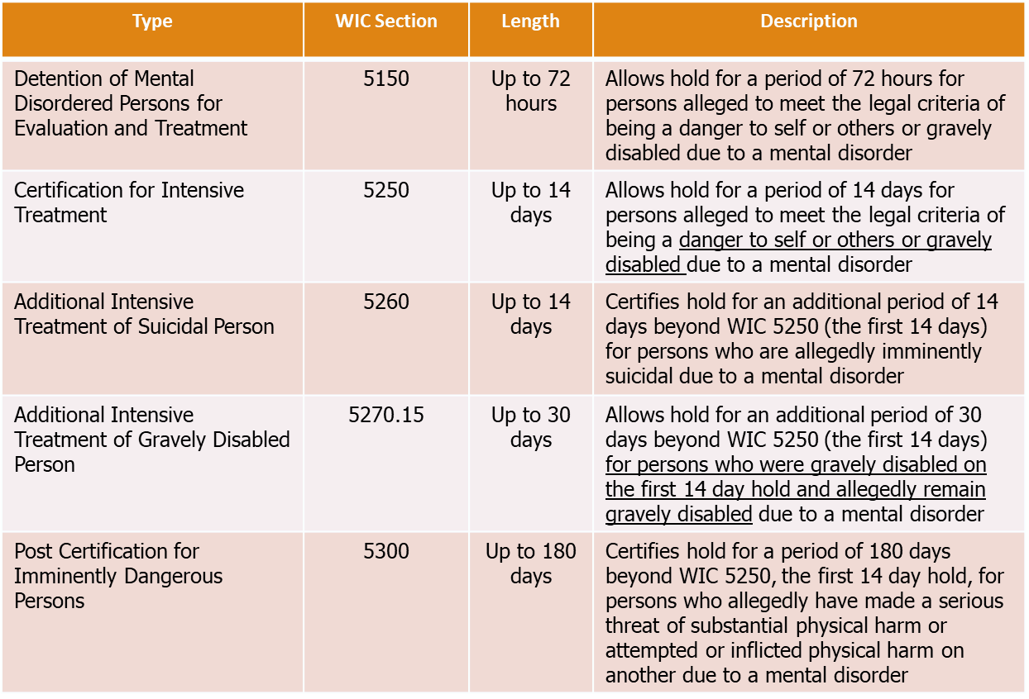

What is an LPS Hold?

Slide 10
WIC 5150 (a)
When a person, as a result of a mental health disorder, is a danger to others, or to themselves, or gravely disabled, a peace officer, professional person in charge of a facility designated by the county for evaluation and treatment, member of the attending staff, as defined by regulation, of a facility designated by the county for evaluation and treatment, designated members of a mobile crisis team, or professional person designated by the county may, upon probable cause, take, or cause to be taken, the person into custody for a period of up to 72 hours for assessment, evaluation, and crisis intervention, or placement for evaluation and treatment in a facility designated by the county for evaluation and treatment and approved by the State Department of Health Care Services. At a minimum, assessment, as defined in Section 5150.4, and evaluation, as defined in subdivision (a) of Section 5008, shall be conducted and provided on an ongoing basis. Crisis intervention, as defined in subdivision (e) of Section 5008, may be provided concurrently with assessment, evaluation, or any other service.

Slide 11
WIC 5150 (b)
When determining if a person should be taken into custody pursuant to subdivision (a), the individual making that determination shall apply the provisions of Section 5150.05 and shall not be limited to consideration of the danger of imminent harm.

Slide 12
WIC 5150 (e)
The application shall also record whether the historical course of the person’s mental disorder was considered in the determination…”

Slide 13
WIC 5150 (g)
(1) Each person, at the time he or she is first taken into custody under this section, shall be provided, by the person who takes him or her into custody, the following information orally in a language or modality accessible to the person. If the person cannot understand an oral advisement, the information shall be provided in writing. The information shall be in substantially the following form:
My name is_______. I am a _____(peace officer/mental health professional)_____with _____(name of agency). You are not under criminal arrest, but I am taking you for an examination by mental health professionals at_____(name of facility). You will be told your rights by the mental health staff.” [WIC 5150 (g)(1)]
(2) If taken into custody at his or her own residence, the person shall also be provided the following information:
You may bring a few personal items with you, which I will have to approve. Please inform me if you need assistance turning off any appliance or water. You may make a phone call and leave a note to tell your friends or family where you have been taken.

Slide 14
It is recommended that you read the entire Welfare and Institution Code 5150 at:
https://leginfo.legislature.ca.gov/faces/codes_displaySection.xhtml?lawCode=WIC&sectionNum=5150

Slide 15
(WIC) 5585 Overview
When a minor, as a result of a mental health disorder, is a danger to others, to self, or Gravely Disabled, a person designated by the county may upon probable cause initiate a 72-hour detention for psychiatric evaluation and treatment.
Children’s Civil Commitment and Mental Health Treatment Act of 1988 (Amended by Stats. 2012, Ch. 457, Sec. 53. (SB 1381) Effective January 1, 2013)
This is a legal process.

Slide 16
(WIC) 5585 Overview
5585.10 - This part shall be construed to promote the legislative intent and purposes of this part as follows:
(a) To provide prompt evaluation and treatment of minors with mental health disorders, with particular priority given to a child or adolescent with serious emotional disturbance.
(b) To safeguard the rights to due process for minors and their families through judicial review.
(c) To provide individualized treatment, supervision, and placement services for minor with a grave disability.
(d) To prevent severe and long-term mental disabilities among minors through early identification, effective family service interventions, and public education. (Amended by Stats. 2014, Ch. 144, Sec. 99. (AB 1847) Effective January 1, 2015)

Slide 17
It is recommended that you read the entire Welfare and Institution Code 5585 at:
https://leginfo.legislature.ca.gov/faces/codes_displayexpandedbranch.xhtml?tocCode=WIC&division=5.&title=&part=1.5.&chapter=&article=

Slide 18
Probable Cause
Probable cause is defined by the presence of facts known to the authorized person that would lead a person of ordinary care and prudence to believe, or entertain a strong suspicion, that person involuntarily detained under the LPS Act suffers from a mental disorder and is a danger to self, a danger to others, or gravely disabled.

Slide 19
Criteria for a Hold
Danger to Self
Danger to Others
Grave Disability

Slide 20
Danger to Self (DTS)
Words or actions that indicate intent to commit suicide or inflict harm upon oneself.
Statements or actions that indicate a specific plan by
which to commit suicide or inflict harm.
Means are available, or within the individual’s ability
to carry out.
The individual refuses to accept or is unwilling to obtain voluntary psychiatric evaluation and treatment.

Slide 21
Danger to Others (DTO)
Indications by words or actions, of an intent to cause bodily harm to another person or other persons.
Identifies means by which individual would do harm to another, and these means are within the individual’s ability to procure.
Engaging in or intent to engage in acts or behaviors of such irrational, impulsive or reckless nature as to put others directly in danger.
Refuses to accept or unwilling to obtain voluntary psychiatric evaluation and treatment.
PLEASE NOTE THAT THERE DOES NOT NEED TO BE AN INTENDED OR IDENTIFIED VICTIM TO BE A DANGER TO OTHERS.

Slide 22
Grave Disability (GD)
  Gravely disabled adult – a condition in which a person, as a result of a mental health disorder, a severe substance use disorder, or a co-occurring mental health disorder and a severe substance use disorder, is unable to provide for their basic personal needs for food, clothing or shelter, maintain personal safety, or access necessary medical care [WIC 5008(a)].
  If a person is able to receive help with food/ shelter/clothing from responsible family members or third parties, then he or she is not considered gravely disabled. (This needs to be put in writing.)
  Homelessness ≠ Gravely Disabled

Slide 23
Indications of Grave Disability
Food
  Unable to obtain/ eat food due to mental health disorder, severe substance use disorder (SUD), and/or co-occurring mental health and SUD
Clothing
  Refuses to wear clothing due to a mental health disorder, severe substance use disorder (SUD), and/or co-occurring mental health and SUD
  Wears clothing that is severely damaged or filthy and/or that is unsuitable for the weather conditions that could represent a health risk.
  Note: Odd or unconventional dress may be due to different cultural norms, personal preference and/or poverty not mental illness.
Shelter
  Refuses to seek for or accept shelter provided by other(s) due to a mental health disorder, severe substance use disorder (SUD), and/or co-occurring mental health and SUD
  Note: A transient lifestyle and/or lack of shelter in and of itself may be due to personal preference or poverty not mental illness.

Slide 24
Grave Disability in Adults Definitions (cont.)
“Severe substance use disorder” means a diagnosed substance-related disorder that meets the diagnostic criteria of “severe” as defined in the most current version of the Diagnostic and Statistical Manual of Mental Disorders.
“Personal safety” means the ability of one to survive safely in the community without involuntary detention or treatment pursuant to [the LPS Act].
“Necessary medical care” means care that a licensed health care practitioner, while operating within the scope of their practice, determines to be necessary to prevent serious deterioration of an existing physical medical condition which, if left untreated, is likely to result in serious bodily injury as defined in W&I Code § 15610.67.

Slide 25
Indications of Grave Disability in Minors
WIC 5585.25
“Gravely disabled minor” means a minor who, as a result of a mental disorder, is unable to use the elements of life that are essential to health, safety, and development, including food, clothing, and shelter, even though provided to the minor by others. Intellectual disability, epilepsy, or other developmental disabilities, alcoholism, other drug abuse, or repeated antisocial behavior do not, by themselves, constitute a mental disorder.
(Amended by Stats. 2012, Ch. 457, Sec. 53. (SB 1381) Effective January 1, 2013.)

Slide 26
Patients’ rights advocacy services (pras)
Section 3

Slide 27
WHAT IS PATIENTS’ RIGHTS ADVOCACY
“Expressed Interest” vs. “Best Interest”
Advocacy is the process of promoting and representing patients’ rights and interests through direct assistance, monitoring, training and policy review.
Advocates ensure that the statutory and constitutional rights of recipients of mental health services are respected.
The Patients’ Rights Advocate represents the “Expressed Interest” of the patient and acts as the patient’s voice when needed.

Slide 28
THE ROLE OF THE PATIENTS’ RIGHTS ADVOCATE
REGARDING LEGAL HOLDS:
Monitor all LPS Designated Psychiatric Units for compliance with Patients’ Rights statutes and regulations.
Audit LPS holds to ensure criteria is appropriately documented.
Review timeliness of the legal holds in accordance with LPS law.
Ensure due process requirements are followed and in compliance for all legal holds.

Slide 29
Psychiatric Hospitals - Minors
Patient Rights
A minor has a right to an independent clinical review
  Completed by a psychiatrist trained in working with adolescents
  Must be a neutral party and able to assess the minor’s need for further inpatient treatment
Any individual under the age of 16, cannot be held with adults receiving LPS treatment

Slide 30
Minor's Additional Rights in a Psychiatric Hospital
To receive a clinical evaluation from a multidisciplinary team that assesses the minor’s biopsychosocial factors and how they may present a problem
Evaluation must include an assessment of family and living environment
A professional who is qualified to work with minors must conduct the evaluation

Slide 31
Completing the New Application for up to 72-hour Assessment, Evaluation and Crisis Intervention or Placement for Evaluation and Treatment (5150/5585 form)
Section 4

Slide 32
FORM TO USE:
Revised March 2026
The Application for up to 72-hour Assessment, Evaluation, and Crisis Intervention or Placement for Evaluation and Treatment (DHCS 1801 03/2026) 5150/5585 form was revised by the Department of Health Care Services (DHCS) effective March 2026.

Slide 33
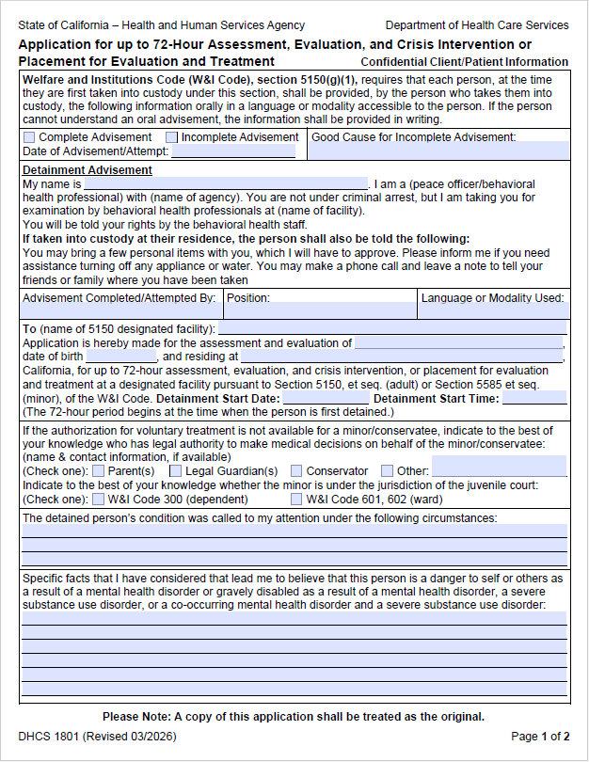
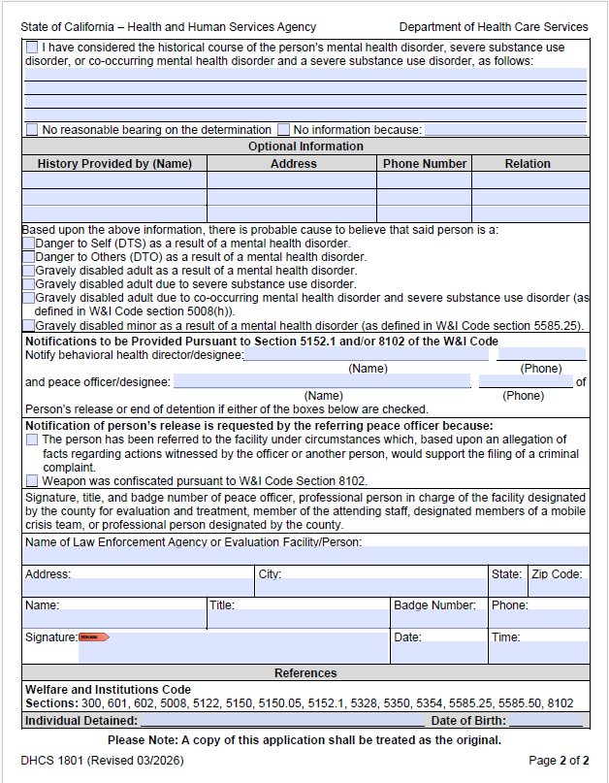

Slide 34
Overview
5150/5585 FORM
PAGE 1 of 2

Slide 35
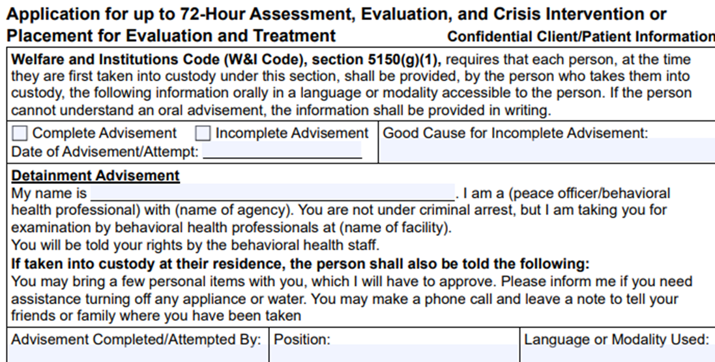
Detainment Advisement Reminders
As the LPS Designated person, you are responsible for advising the individual, and you must complete the advisement section:
  Provide the advisement to the individual, verbally, and in a language or modality accessible to the person OR
  The information must be provided in writing if the individual cannot understand the oral advisement. Translation of the advisement portion of the 5150/5585 form is available in all the threshold languages.
You must complete the Advisement section portion of the form with your name and the date the advisement was given.
You must check the box indicating whether you advised the individual. If you check, Incomplete Advisement, that you did not advise the member, you must note the good cause why you did not advise the member. (Example: The person is unable to comprehend the advisement and evaluation)

Slide 36
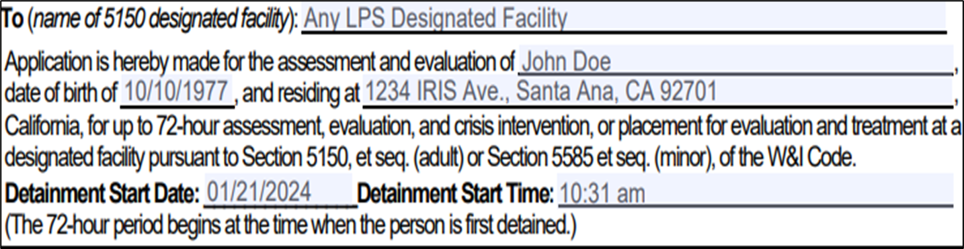
Demographic information
Note: Page 1 will consist of the start time an individual has been detained (start of the 72 hours)

Slide 37
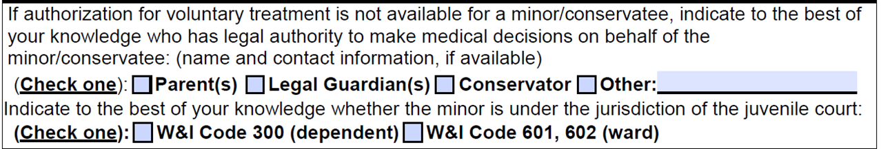
Demographic information
For minor/conservatee, document on the hold why no voluntary admission is possible.
If the person is a minor, you will need to check the appropriate box to indicate who is legally responsible for the minor.

Slide 38

Special legal status of minors
W&I Code 300 (dependent)- Minor that has been removed from parental custody due to abuse or neglect (foster youth) and are dependents of the court
  Under supervision of social worker
  Social worker info would go on hold
  Foster parent address or group home address that minor resides in would go on hold

Slide 39
Special legal status of minors
W&I Code 601/602 (Ward)
  601- A minor who is persistently truant, disobeys their parents, or is beyond their control, is considered a ward of the court
  602- A minor who violates any state or federal law, or a local ordinance defining a crime, is considered a ward of the court
Under supervision of probation, Probation officer on hold

Slide 40
Minors involved with
Social Services or Probation
Minors who are wards or dependents of the court are always placed on a 72-hour Involuntary Detention if they meet criteria for hospitalization
Assigned a social worker or probation officer who serves as the minor’s assigned guardian

Slide 41
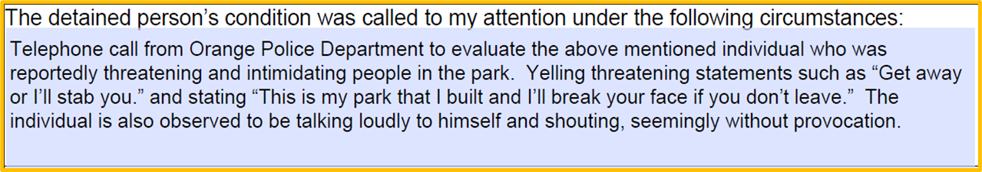
Detained person’s condition
INDICATE THIS INFORMATION IN THIS PART OF THE FORM:
  Brief description of how the individual’s condition was brought to your attention
  Provide only relevant facts
Example:

Slide 42
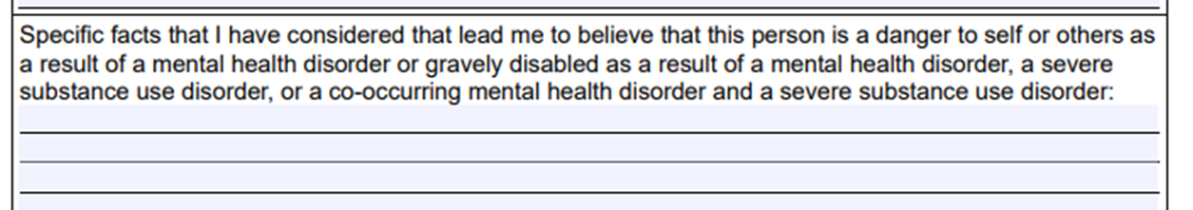

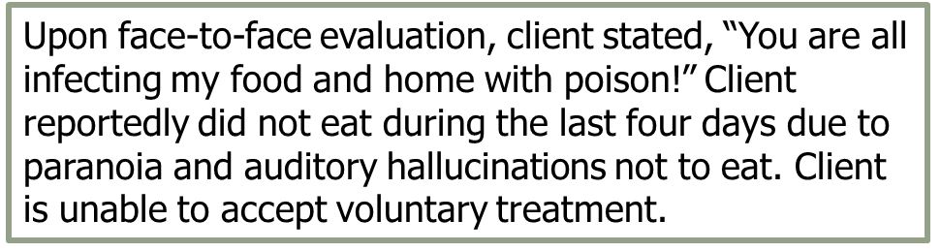
Specific facts
INDICATE THE INFORMATION BELOW IN THIS PART OF THE FORM:
  Brief description of the individual (i.e. age, appearance)
  Observable behaviors or “quotes” of individual’s statements
  Note if the individual is unable or unwilling to accept voluntary treatment
  Description of behaviors and/or situation observed or reported

Slide 43
Reminder to Describe Behaviorally and with Specific Detail
Instead of: “Individual was highly anxious and agitated.”
Write: “The individual was pacing the room, crying, appeared very upset, and was expressing extensive fears and feeling overwhelmed about pending final exams.”
Instead of: “Individual was experiencing command hallucination instructing her to harm others.”
Write: “Individual was hearing voices telling her to strangle her sister.”

Slide 44
Reminder to Use Behavioral Terms, Not Psychological Jargon
Instead of: Individual is threatening to commit suicide
Write: Individual is stating a plan to kill himself by hanging.
Instead of: Minor is a potential danger to others and is acting aggressively and violently toward his mother.
Write: Minor is brandishing a knife and attempting to slash his mother.

Slide 45
Overview
5150/5585 FORM
PAGE 2 of 2

Slide 46
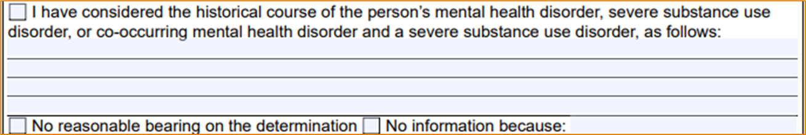
HISTORICAL COURSE
Welfare and Institutions Code section 5150.05
(a) When determining if probable cause exists to take a person into custody, or cause a person to be taken into custody, pursuant to Section 5150, a person who is authorized to take that person, or cause that person to be taken, into custody pursuant to that section shall consider available relevant information about the historical course of the person’s mental disorder if the authorized person determines that the information has a reasonable bearing on the determination as to whether the person is a danger to others or to themselves, or is gravely disabled.
(b) For purposes of this section, “information about the historical course of the person’s mental disorder” includes evidence presented by the person who has provided or is providing mental health or related support services to the person subject to a determination described in subdivision (a), evidence presented by one or more members of the family of that person, and evidence presented by the person subject to a determination described in subdivision (a) or anyone designated by that person.
Note: only check one box.

Slide 47
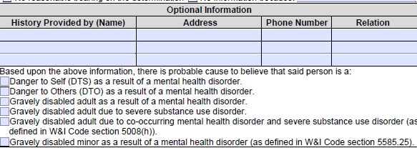
COLLATERAL INFORMATION
The Name and contact information of the person(s) who provided collateral information should be captured here. This section is OPTIONAL as the person providing collateral information has a right to decline to provide their name or contact information.

Slide 48
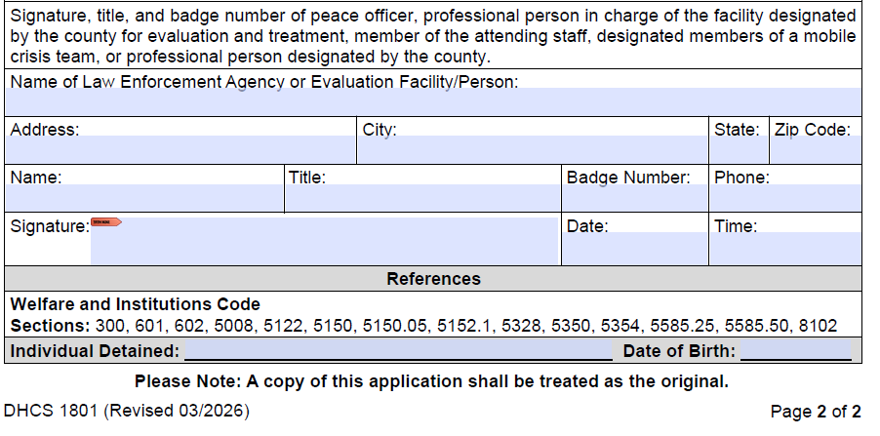
Note: Page 2 will include the time that this 510/5585 form has been fully completed. The time on page 1 and page 2 will differ.

Slide 49
The 5150/5585 Form is a Legal
Document: Be Attentive
It must be legible (press hard for carbon copy)
It must be filled out completely
All boxes must be checked
Utilize the accurate and real time
Verify that it is correctly dated
It must be signed

Slide 50
Resources
County Policies and Procedures: https://www.ochealthinfo.com/bhs/pnp
Abuse Reporting: http://ssa.ocgov.com/abuse/
Tarasoff / Duty to Protect: Duty to Protect
Special Incident Reports:
  County Providers: HCA Operations & Support - Agencywide Policy & Procedures - All Documents
  Contractors use their own P&P’s and reporting
County webpage for Senate Bill 43
  https://www.ochealthinfo.com/services-programs/mental-health-crisis-recovery/crisis-services/california-senate-bill-43-sb43

Slide 51
Sources from training
Welfare & Institution Code, Sections: 5008 (A), 5008(e), 5150, 5150(a), 5150.05, 5358(d), 5358.5

Slide 52

Thanks for reading! See the required pre-training forms at the LPS Designation webpage for the next step of the process.
Any questions or concerns, please e-mail BHPDesignation@ochca.com

Slide 53



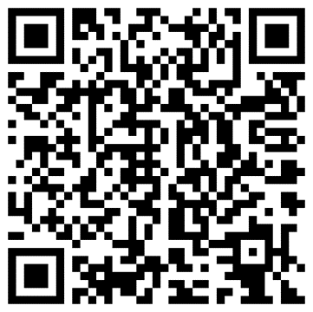



Stay Connected
OC Health Care Agency
@ochealthinfo
@ochealth
@oc_hca
@ochealth
www.ochealthinfo.com

